Slide 1
Plugin Development
Understanding the new patterns and tools for plugin development

Slide 2
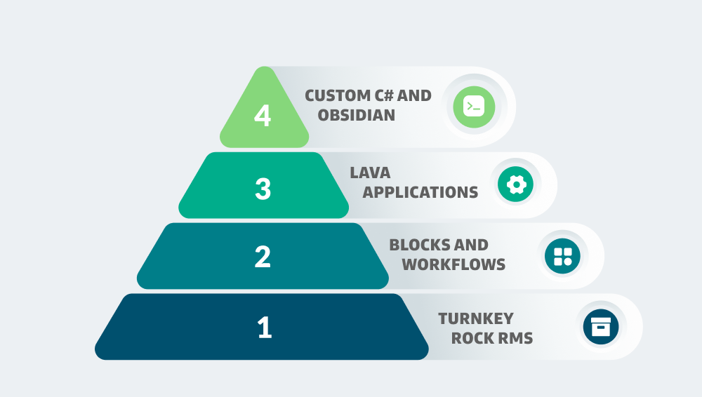
Notes:
Braden Cohen has a session on Lava Applications later today.
Not going to show you exactly what code to write to do things; Come back for Nick Airdo’s session next hour for some of that.
Focusing on concepts and patterns & making use of the tools the core team provides.

Slide 3
The Old Way

Slide 4
Rockit
Fork of the Rock repository with your custom plugins.
Takes up a lot of disk space.
CI builds are complex to setup.
Slower build times.
Updating Rock version required merging in a Spark release branch into your fork.

Slide 5
Rockit
Option 1
Option 2
Single branch​
Multiple branches
Can work with all plugins at the same time.
Updating Rock version updates all plugins.
Must switch branches between plugins.
Rock can be updated for one plugin.
Notes:
Option 1: This can cause headaches because you might need to fix issues in a plugin you weren’t planning on touching today.
Option 2: Can slow down development if you need to test how two plugins interact with each other.

Slide 6
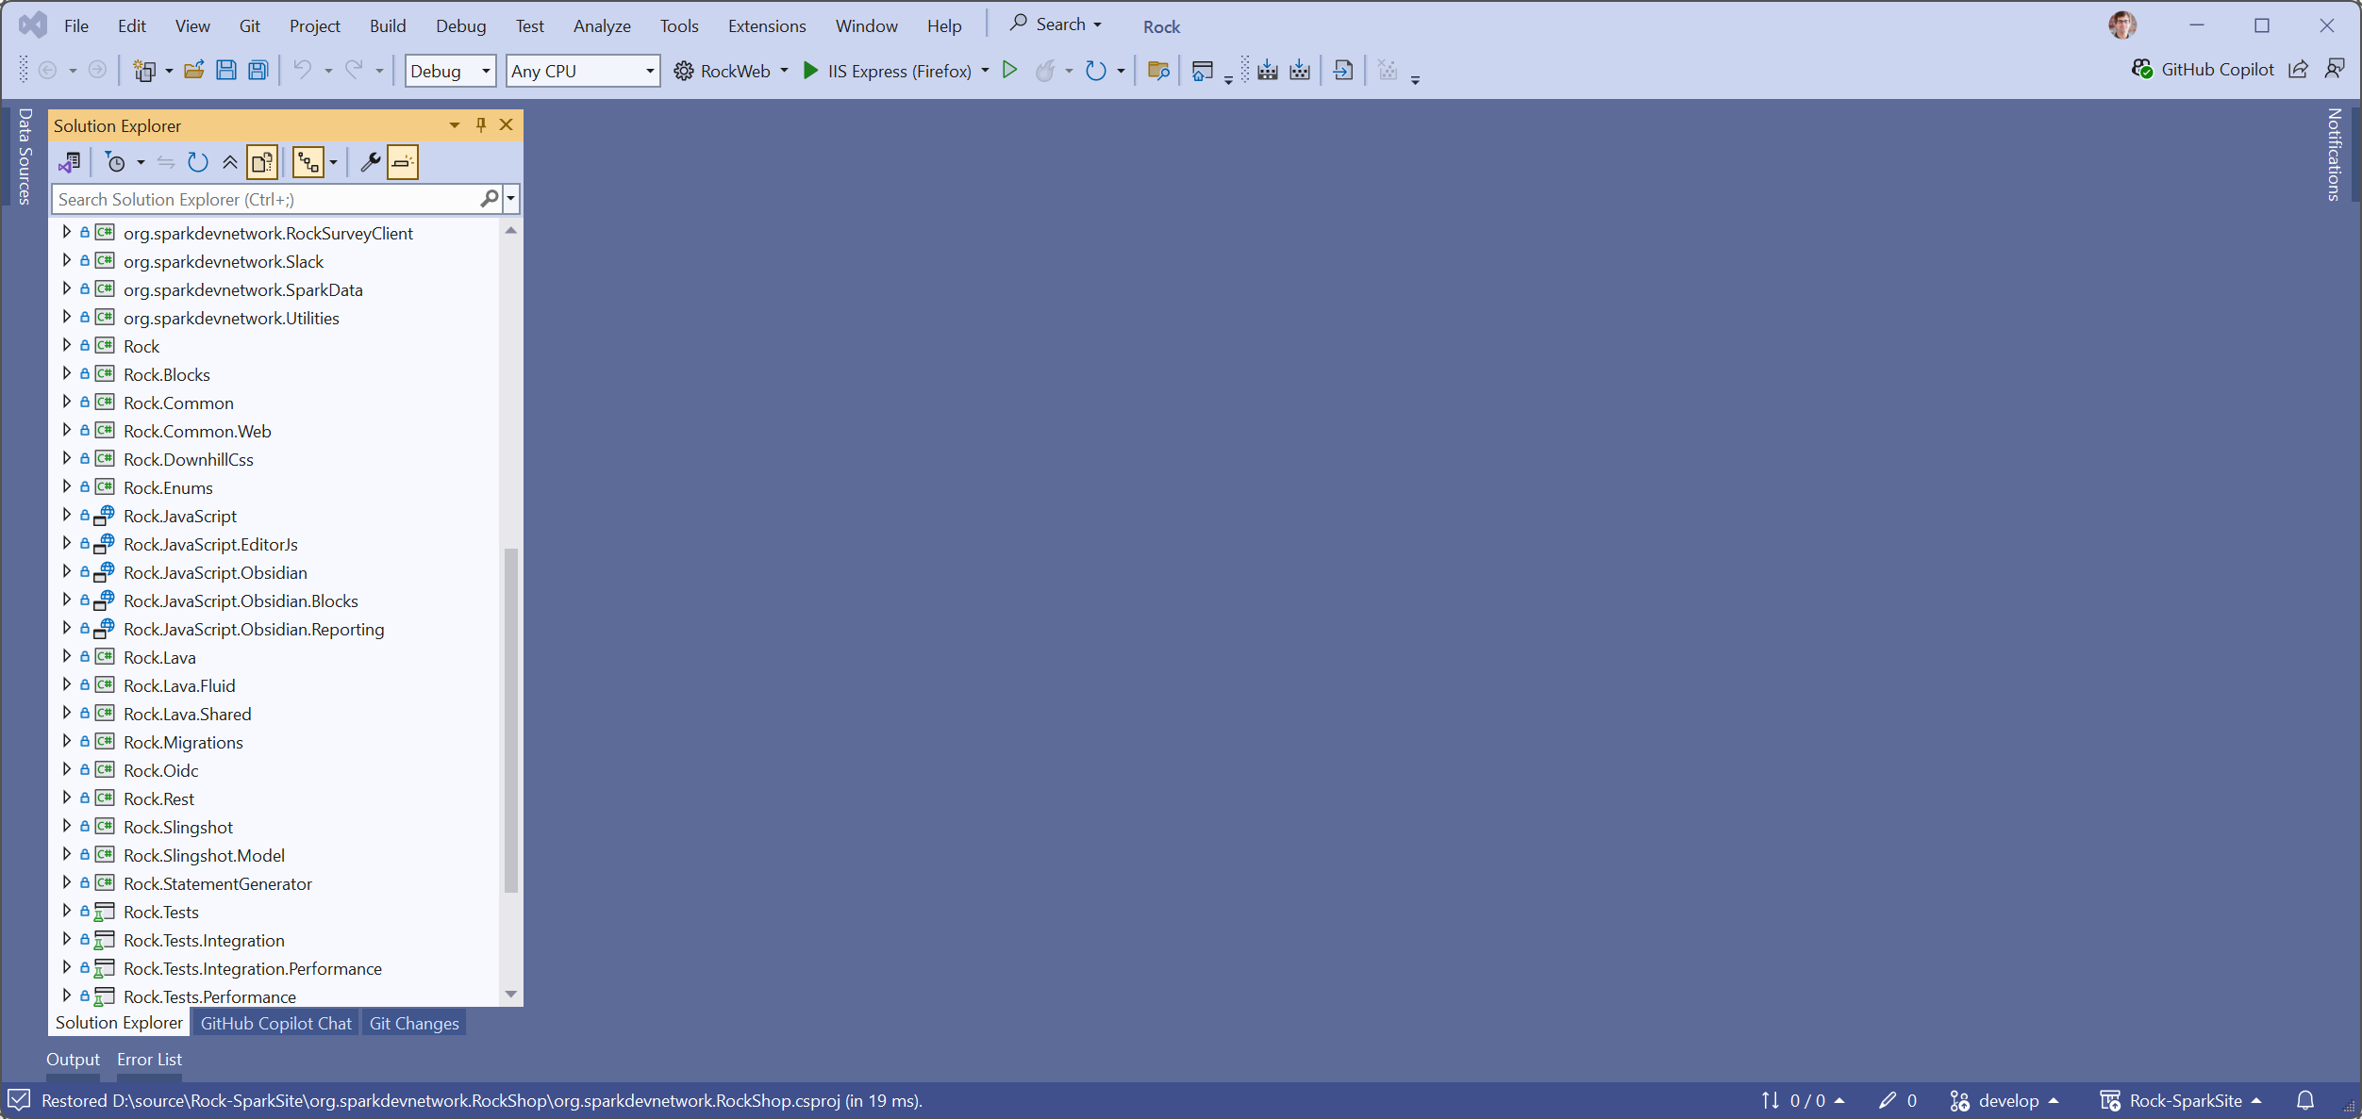
Rockit

Slide 7
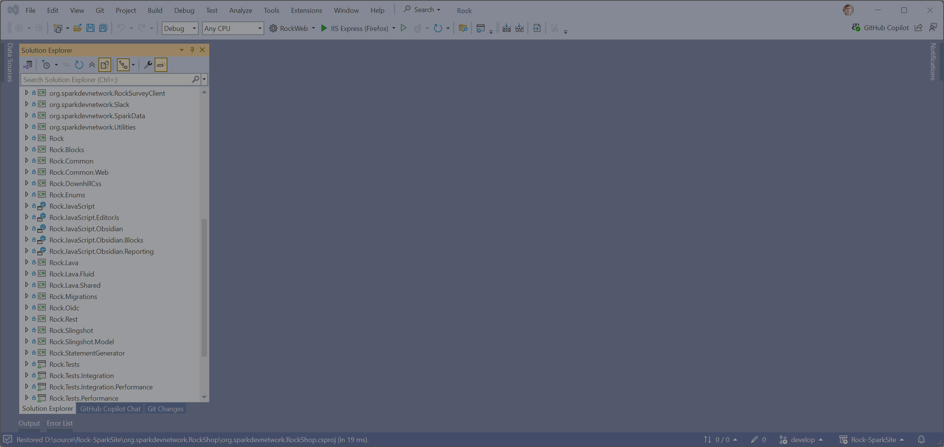
Rockit

Slide 8
New Multi-Repository Pattern
Notes:
This the new recommended pattern.
There are other ways to do this, but this is the only officially supported pattern.

Slide 9
Repositories
Plugin A
Plugin B
Plugin C

Slide 10
Repositories
Plugin A
Environment
Plugin B
Plugin C

Slide 11
Terminology
Plugin
Environment
A collection of projects.
Defines version of Rock when compiling.
Contains the csproj file.
No Rock projects or files.
A collection of plugins.
Defines version of Rock when running.
Contains the Visual Studio sln file.
No Rock projects or files.

Slide 12
Repositories
Clean repository, not a fork of Rock.
Minimal disk space requirements.
Only NuGet and NPM references.
CI builds are easier to setup.
Faster builds.

Slide 13
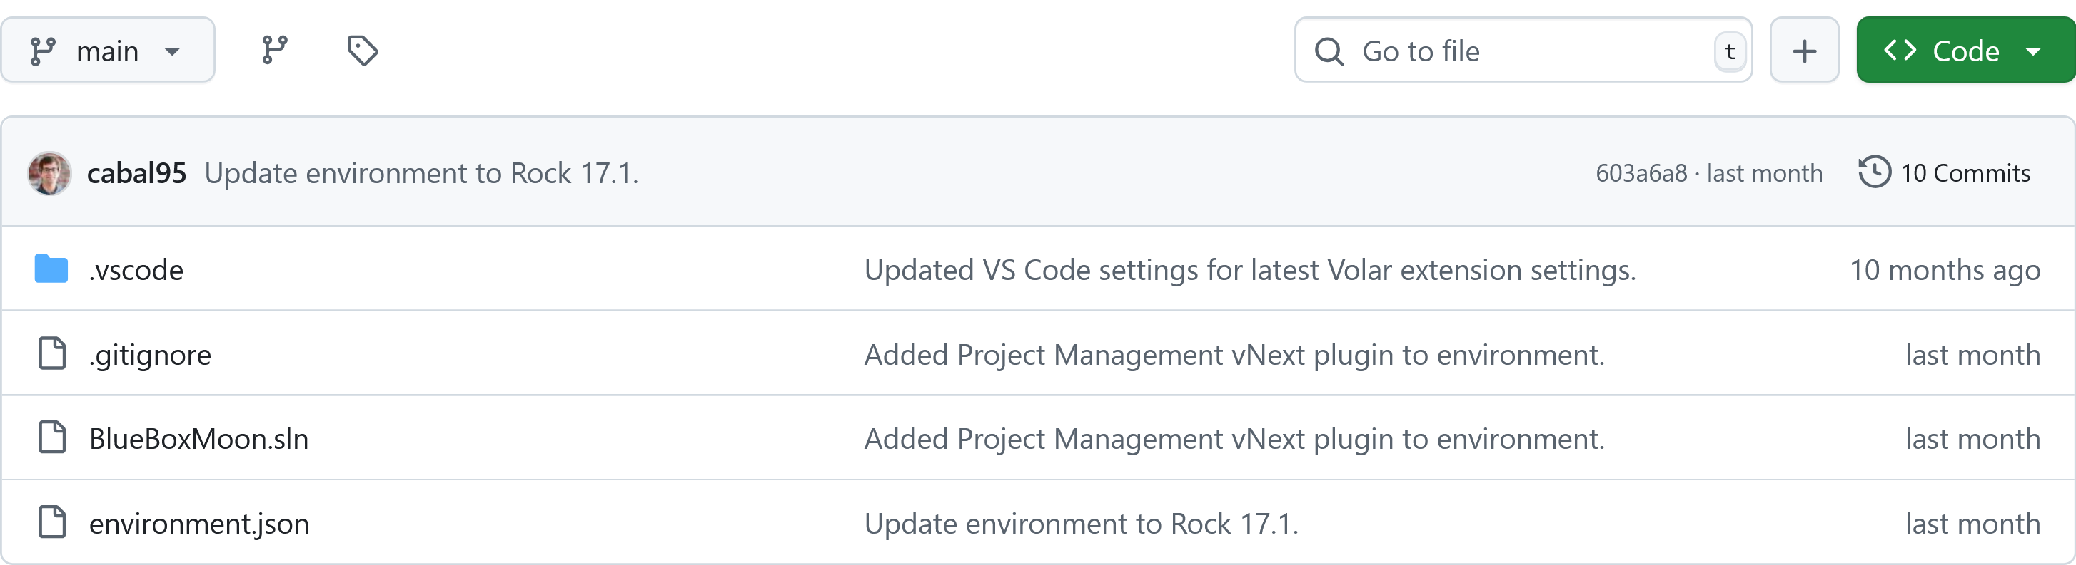
Environment Repository

Slide 14
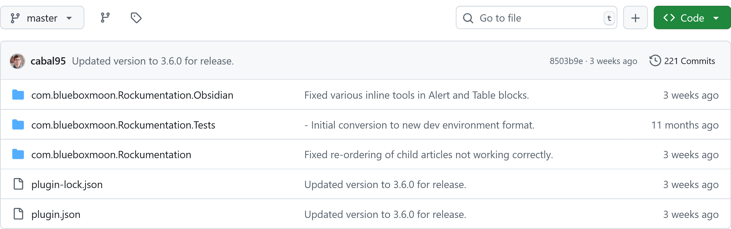
Plugin Repository

Slide 15
Repositories
Plugin A
Environment
Plugin B
Plugin C

Slide 16
Directory Structure
Environment
Plugin A
Plugin B
Plugin C

Slide 17
Directory Structure
Environment
Plugin A
Plugin B
Plugin C

Slide 18
Directory Structure
Environment
.vscode
.gitignore
BlueBoxMoon.sln
environment.json
Plugin A
Plugin B
Plugin C

Slide 19
Directory Structure
Environment
.vscode
.gitignore
org.example.PluginB
BlueBoxMoon.sln
org.example.PluginB.Obsidian
environment.json
plugin-lock.json
Plugin A
plugin.json
Plugin B
Plugin C

Slide 20
Directory Structure
Environment
.vscode
.gitignore
org.example.PluginB
Blocks
BlueBoxMoon.sln
org.example.PluginB.Obsidian
Enums
environment.json
plugin-lock.json
Migrations
Plugin A
plugin.json
Model
Plugin B
ViewModels
Plugin C
org.example.PluginB.csproj

Slide 21
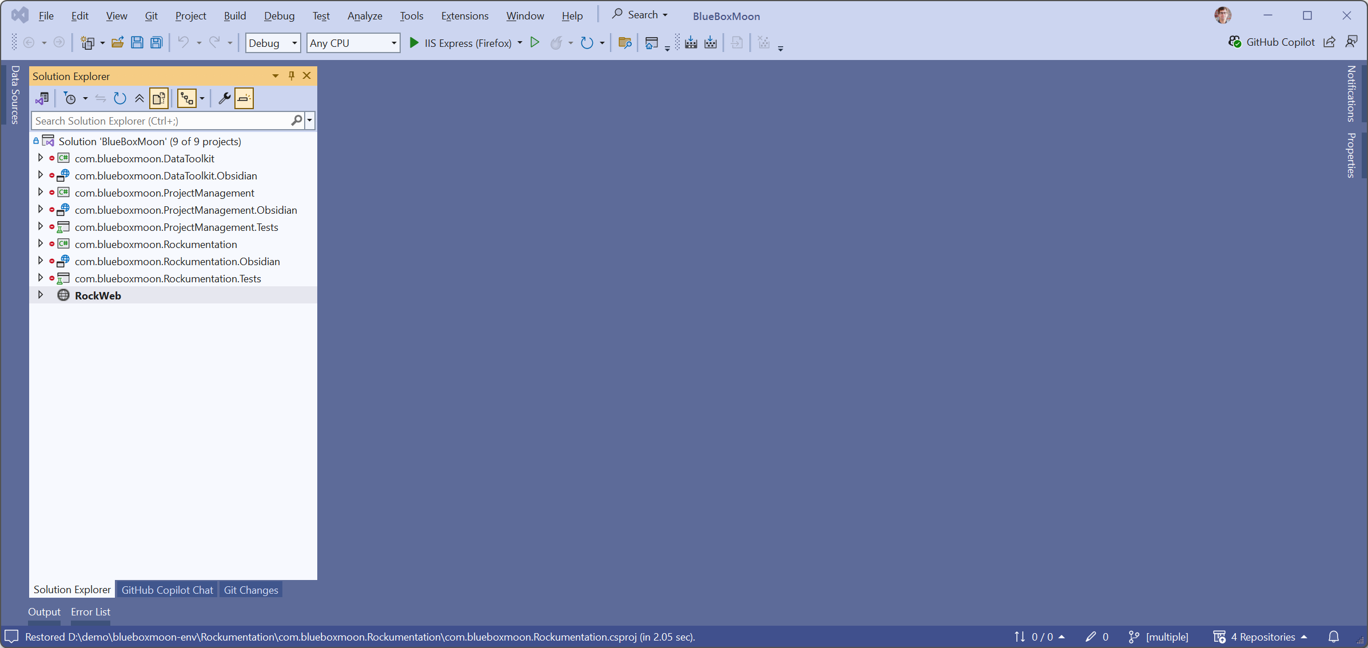
Streamlined Solution

Slide 22
Support Tools
Notes:
Command Line Tool
NuGet to help with build process.
NuGet for code analyzers.
Npm packages with build tool chain.

Slide 23
CLI Tool
Create new environments.
Initializing environment on your development machine.
Create new plugins.
Configure plugin repository URLs in environment.
Pack plugin into archive for Rock Shop distribution.
Generate TypeScript files from C# enums and bags.
Generate list block from C# model.
Generate detail block from C# model.

Slide 24
Development Packages
Development libraries are published to NuGet and NPM.
Pre-compiled RockWeb instances are stored in Azure.
Updating development Rock version is a simple NuGet update.
Updating testing Rock version is a simple CLI command.

Slide 25
Notes:
Seldom seen at RX.
Presenters run in fear from this.

Slide 26
Live Demo
Notes:
Create a new environment.
Create a plugin.
Create a list block and detail block.

Slide 27
Questions?

Slide 29
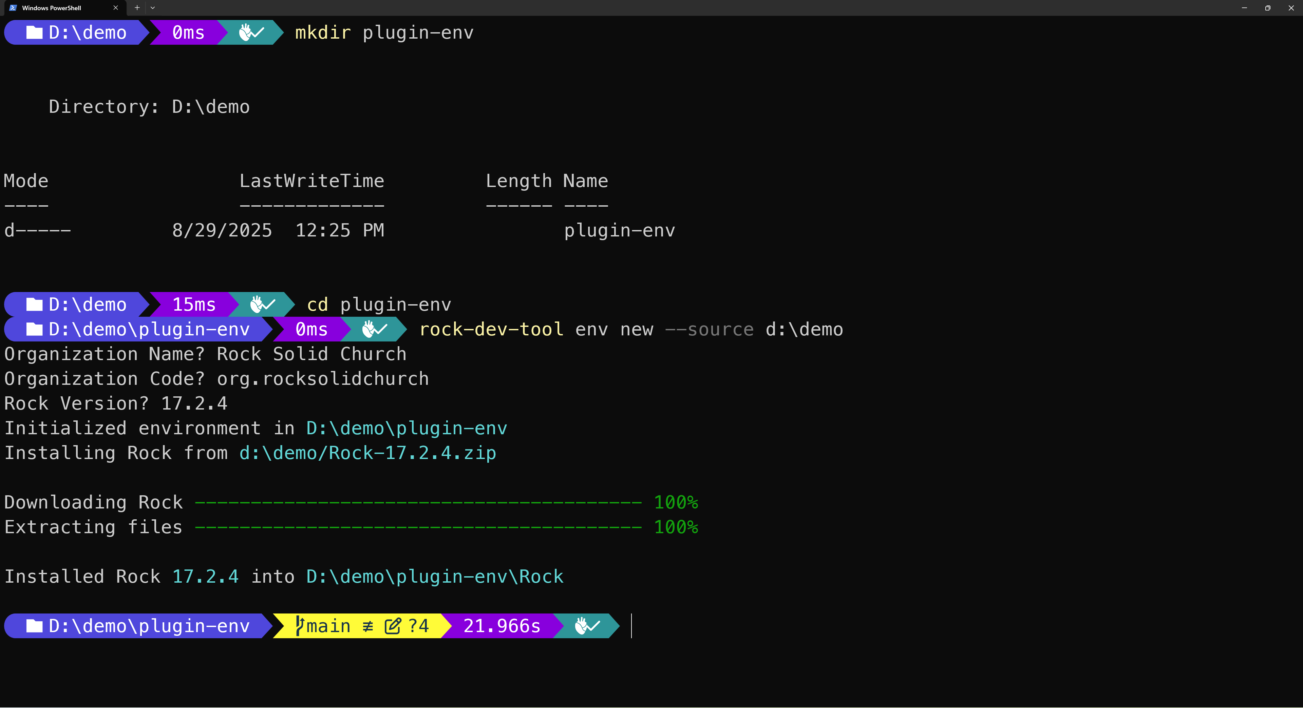

Slide 30
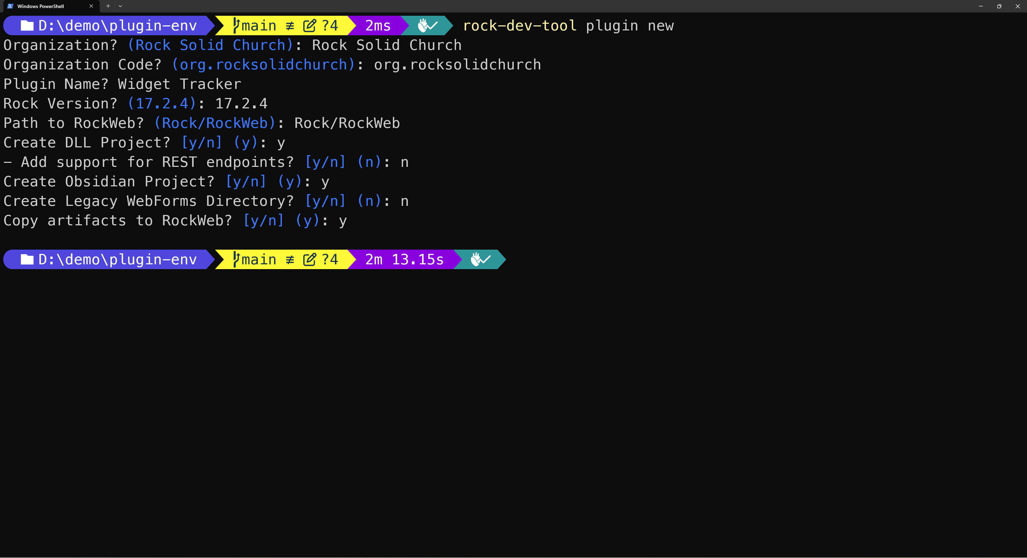

Slide 31
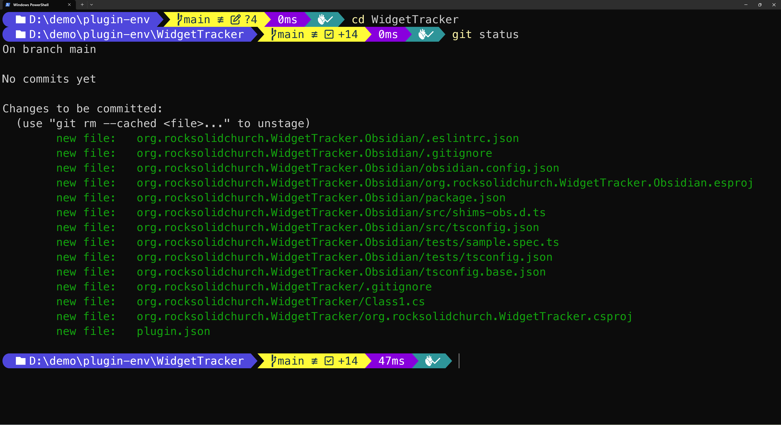

Slide 32
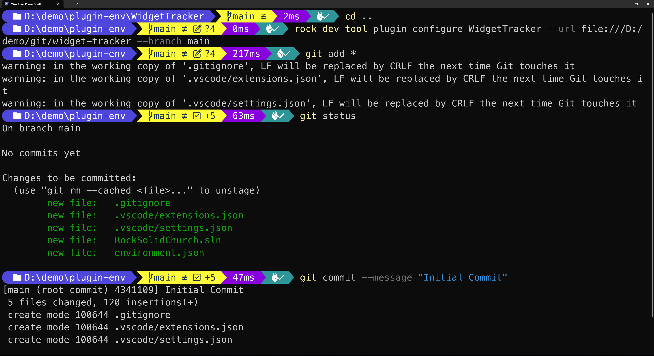

Slide 33
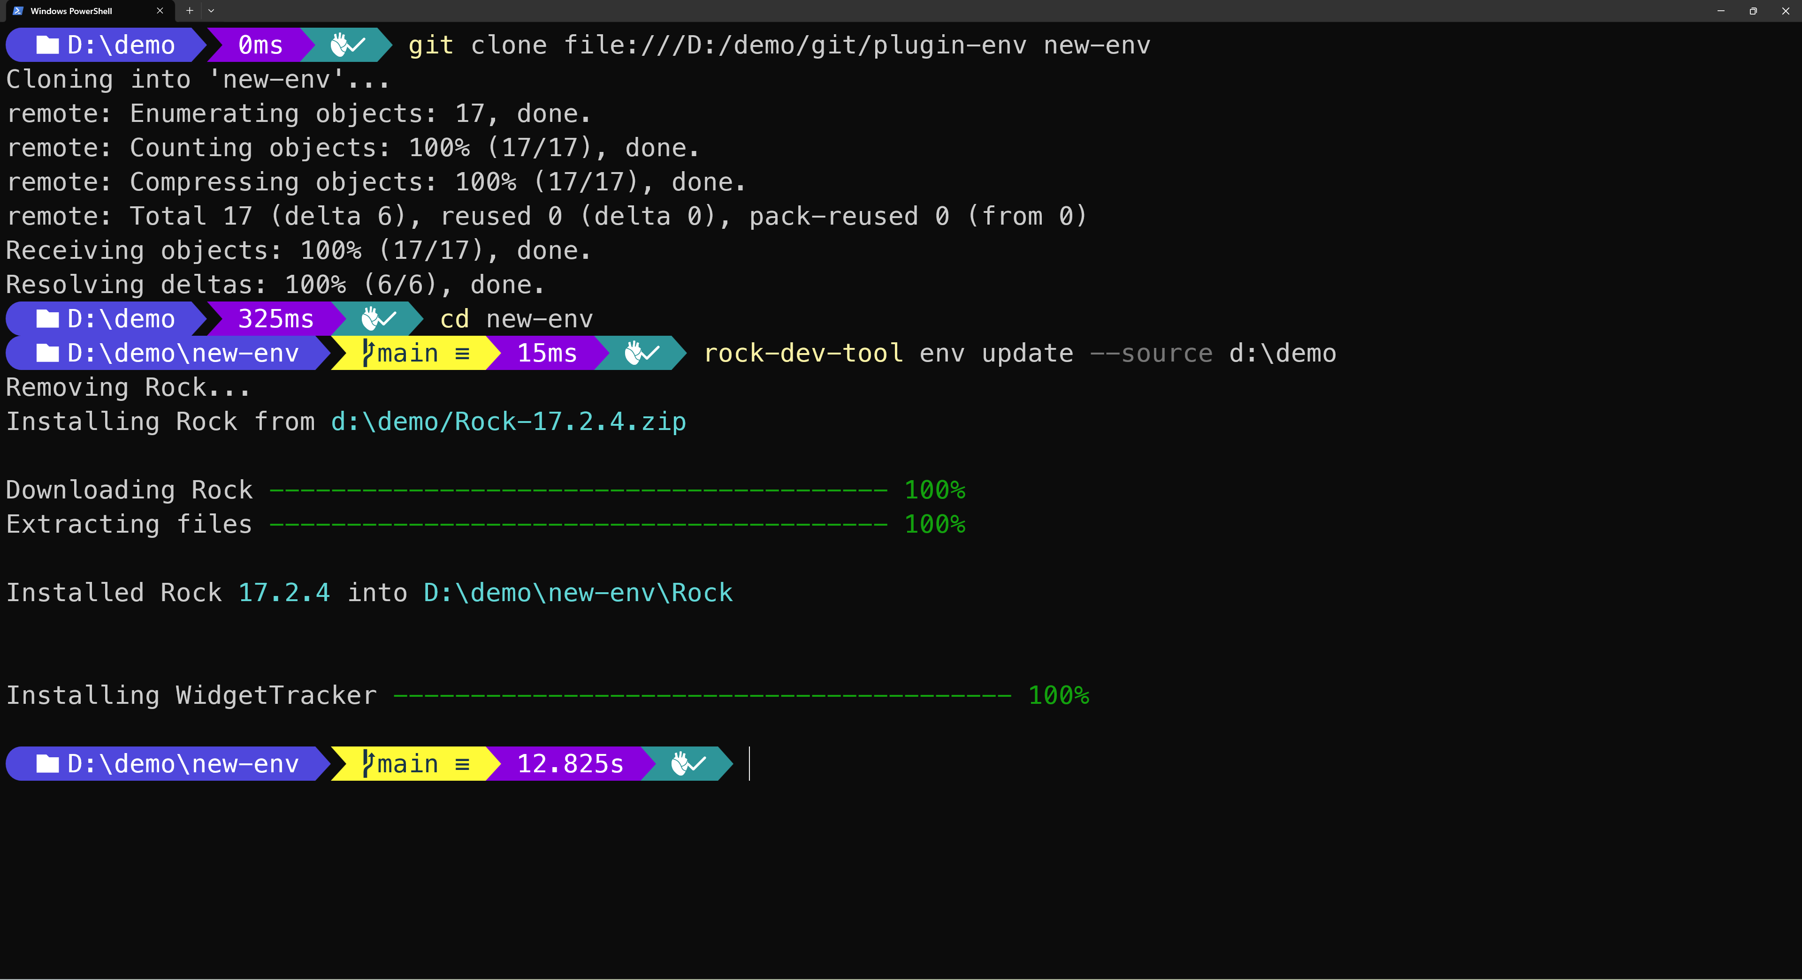

Slide 34
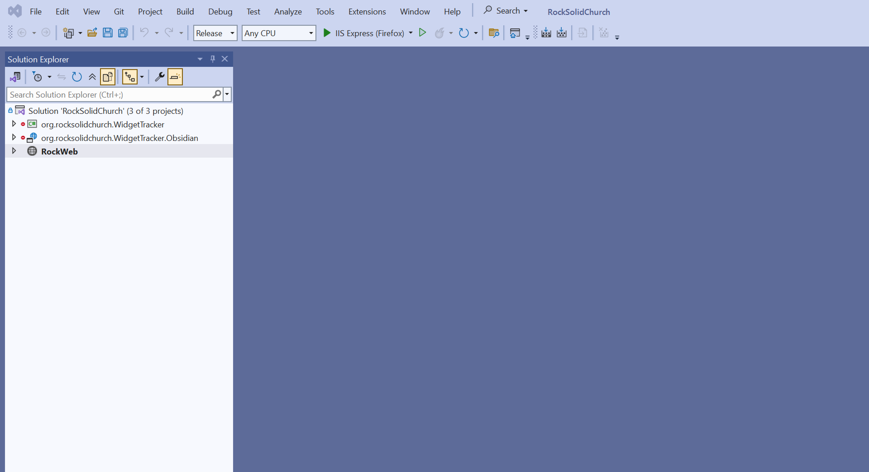

Slide 35
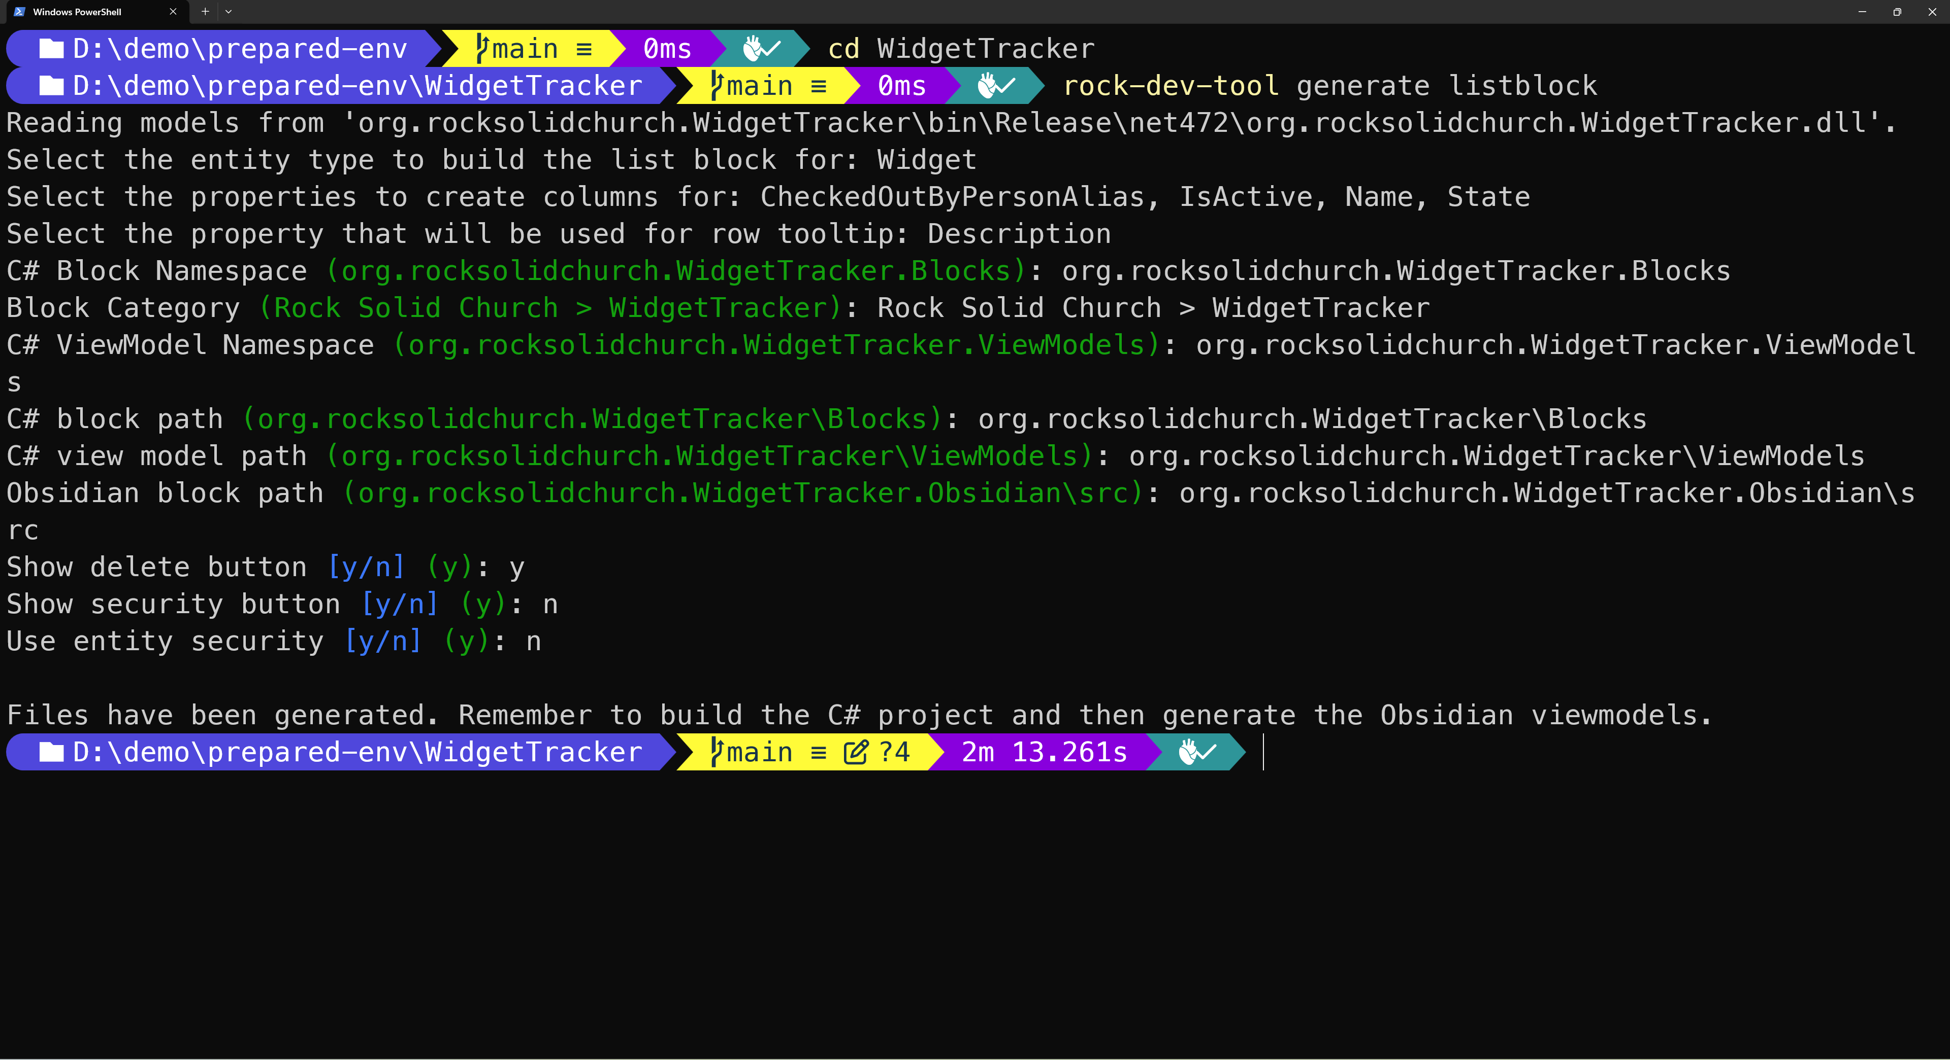

Slide 36
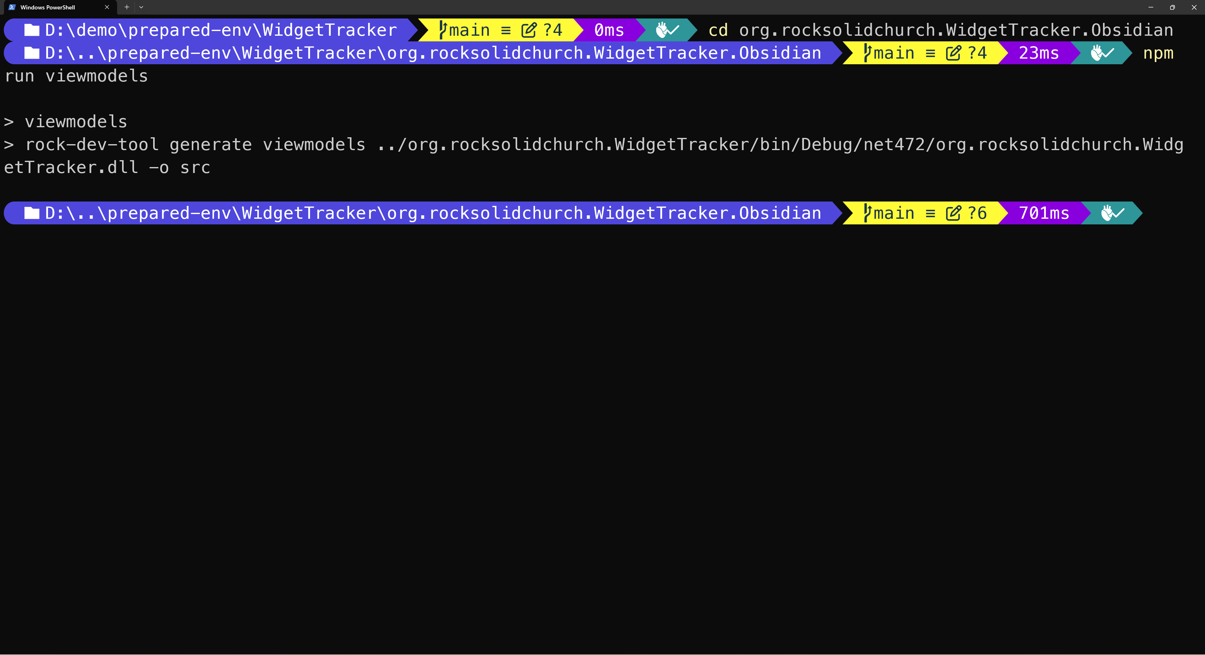

Slide 37
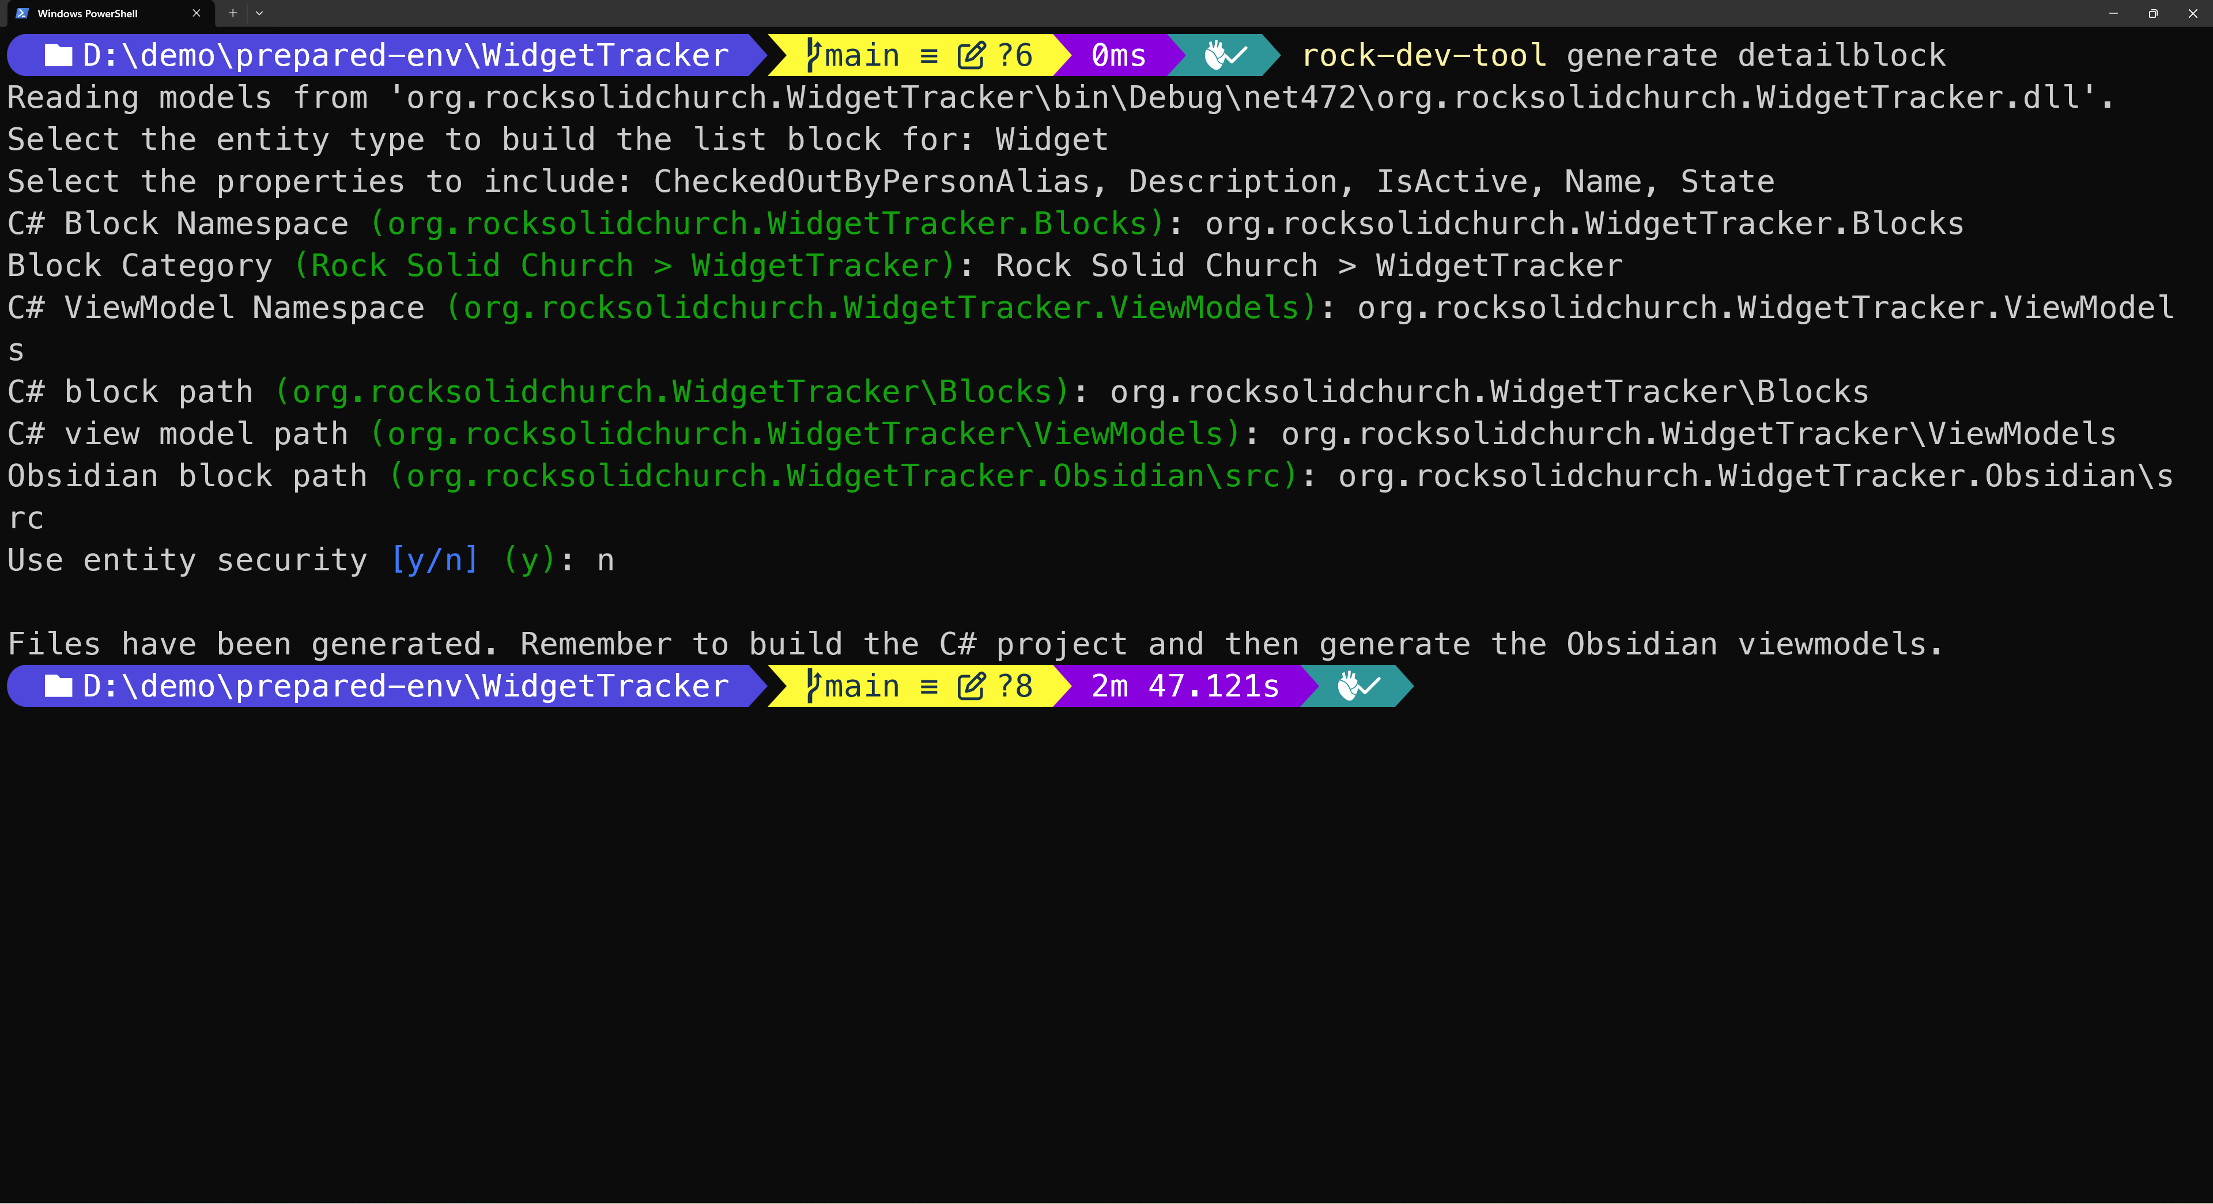

Slide 39
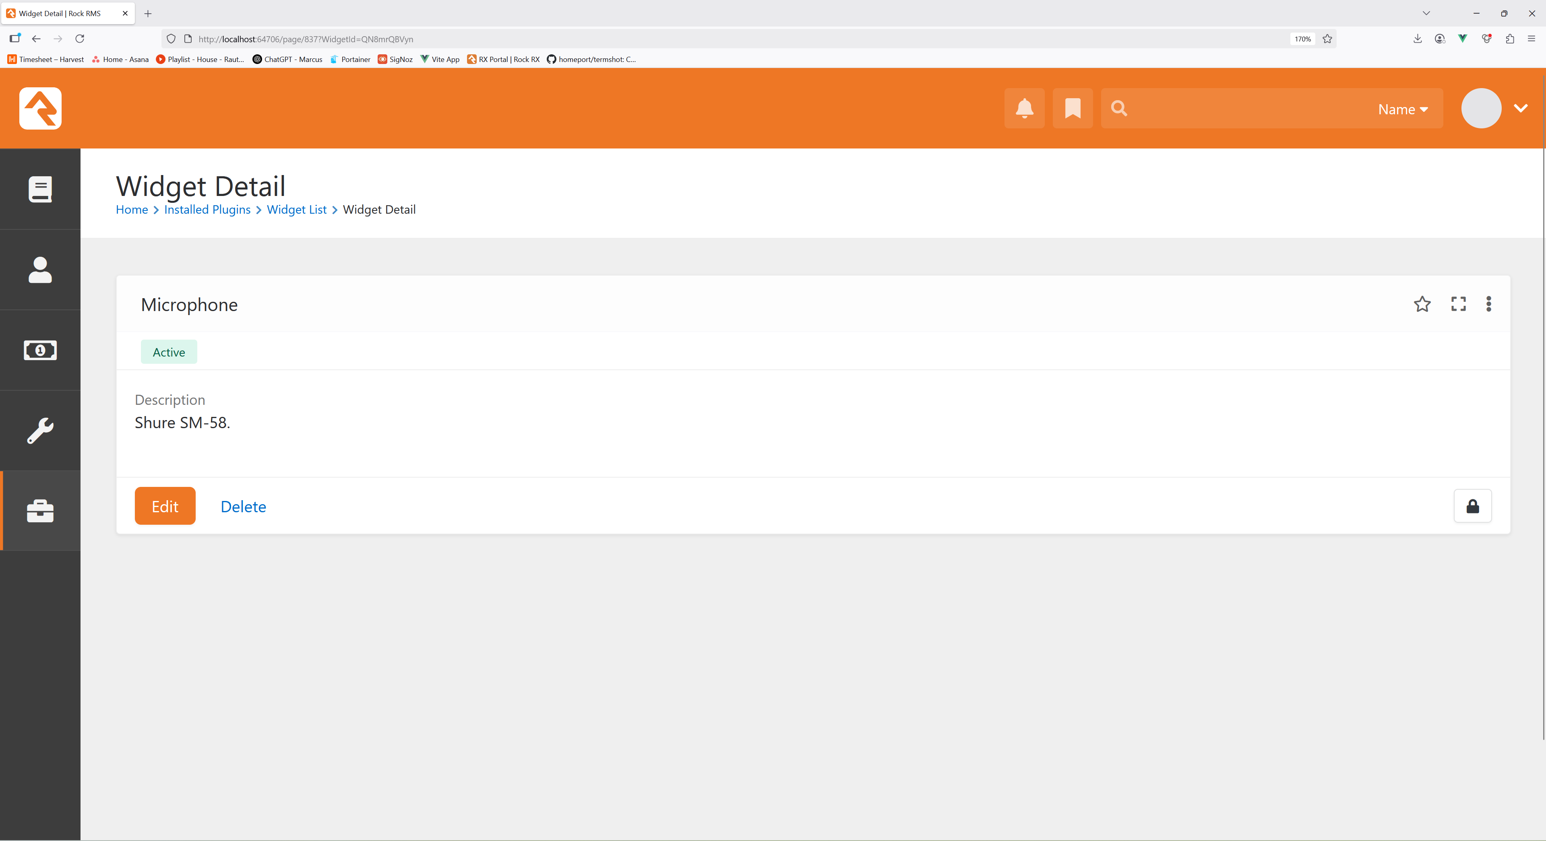

Slide 40
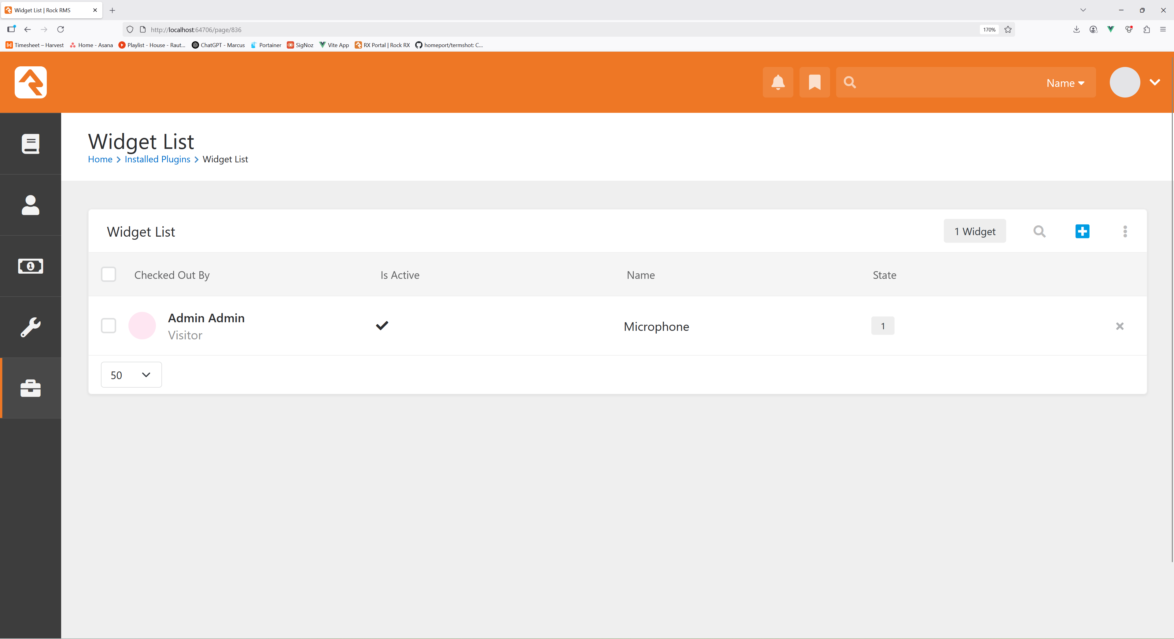

Slide 41
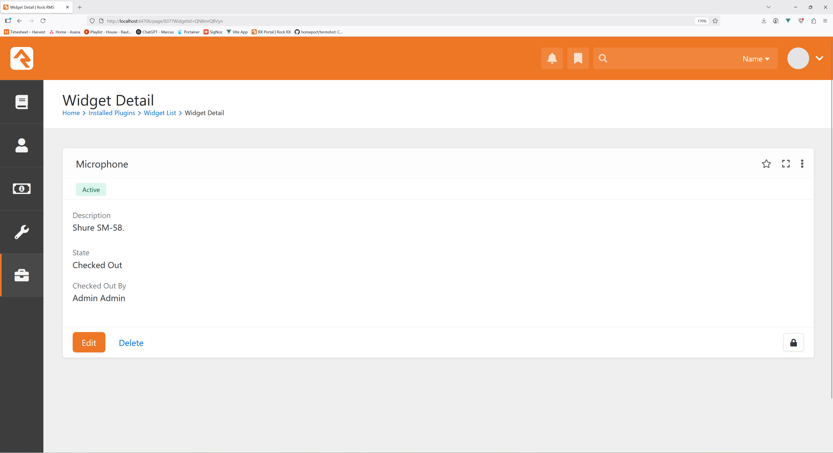

Slide 42
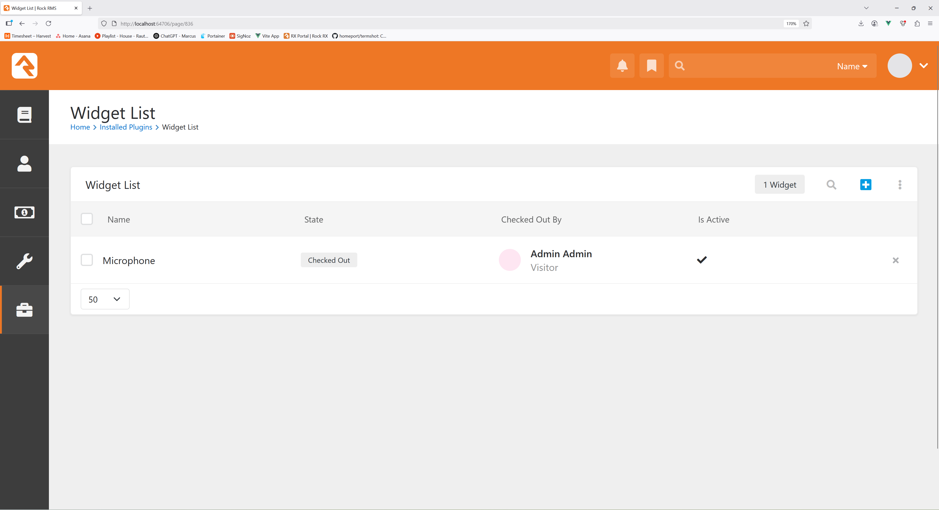

Slide 43
Questions?

