Slide 1
From Concept to Completion: Mastering Rock’s LMS
Kyle Henning
Notes:
High-Level
Goal: What entities are, how they are related

Slide 2

What is an LMS?
Built-in training platform inside Rock
Organize Programs → Courses → Classes → Learning Plans
Deliver activities: video, assessments, acknowledgments, file uploads
Two delivery modes: On-Demand (self-paced) or Academic Calendar (semester-based)
Surfaces: Admin (/people/learn) & Learning Hub (/learn)
Notes:
Rock’s LMS is a built-in learning platform. You don’t need a third-party system—it’s all right inside Rock.
It lets you structure training with four building blocks: Programs, Courses, Classes, and Learning Plans.
Students complete different types of activities—watching a video, acknowledging a statement, taking assessments, or submitting files.
There are two ways to run programs: On-Demand, which is continuous and simple, or Academic Calendar, which is semester-based with extra features like a syllabus and class progress bar.
Admins work in /people/learn to set everything up; learners go to /learn to browse, enroll, and complete their training.

Slide 3




Why use Rock's LMS?
Growth
Team
Mission
Build discipleship
& leadership pathways
Simplify and standardize
staff onboarding
Train & equip volunteers
for ministry roles
Notes:
Growth - Growth is about discipleship and leadership pathways. You can build multi-step tracks for spiritual formation, create leadership pipelines, or even run semester-based residencies.
Team - Team focuses on staff. The LMS helps you simplify and standardize onboarding so every new hire experiences the same culture, values, and required training. No steps get missed, and managers save time by not reinventing onboarding for each person.
Mission - Mission is about equipping volunteers for ministry. From kids’ safety training to hospitality or security teams, the LMS ensures consistent preparation, protects your church, and makes it easy to track who is ready to serve.

Slide 4
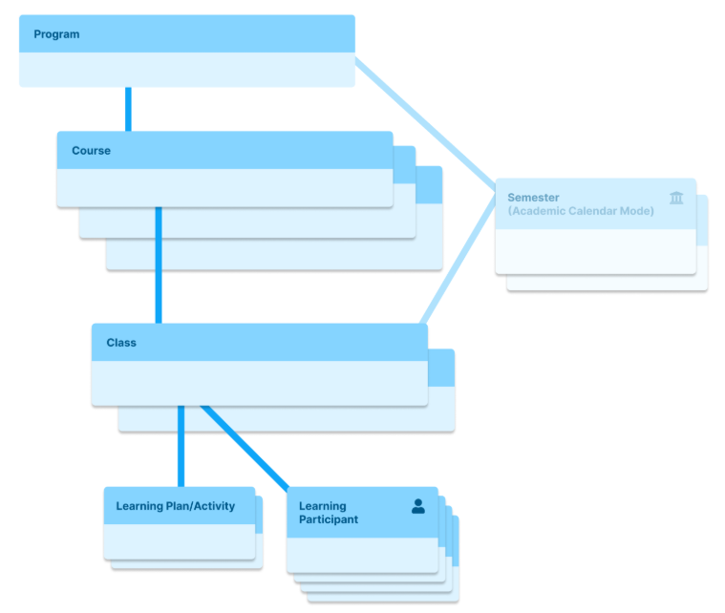
LMS Overview​
Program: Highest level; a collection of related Courses.
Course: Specific subject offered in a Program.
Semester (Academic Mode only): Time block grouping Classes.
Class: An instance of a Course.
Learning Plan / Activities: The building blocks of a Class.
Students & Facilitators: Students enroll and complete Learning Plans. Facilitators manage students and grade their work.
Grading System: Completion, Pass/Fail, or Letter Grade (customizable)
Notes:
Before we dive into building a program, let’s clarify some key terms, because the LMS is hierarchical.
At the top is the Program—it’s the big umbrella. A Program is a collection of related Courses, like a Student Residency or Volunteer Training.
Each Course is a subject. For example, a Course in Biblical Studies could be ‘Gospels’ or ‘Hermeneutics.’
If you’re running in Academic Calendar mode, you’ll add Semesters like ‘Fall 2025’ to group Classes into timeframes. On-Demand mode skips this step.
A Class is an actual offering of a Course. So you might have the Course ‘Gospels’ with a Class called ‘Gospels – Spring 2025.’
Inside each Class, you build a Learning Plan, which is a sequence of Activities—watch a video, take a quiz, acknowledge a policy, upload an assignment.
You’ll assign Students to take the Class and Facilitators to grade. And you’ll choose a Grading System—whether that’s simple Completion, Pass/Fail, or a Letter Grade.
This diagram brings it all together: Programs contain Courses, Courses have Classes, Classes have Learning Plans, and people participate as Students or Facilitators. Semesters only come into play if you need the Academic Calendar structure.

Slide 5
LMS Configuration Walkthrough

Slide 6
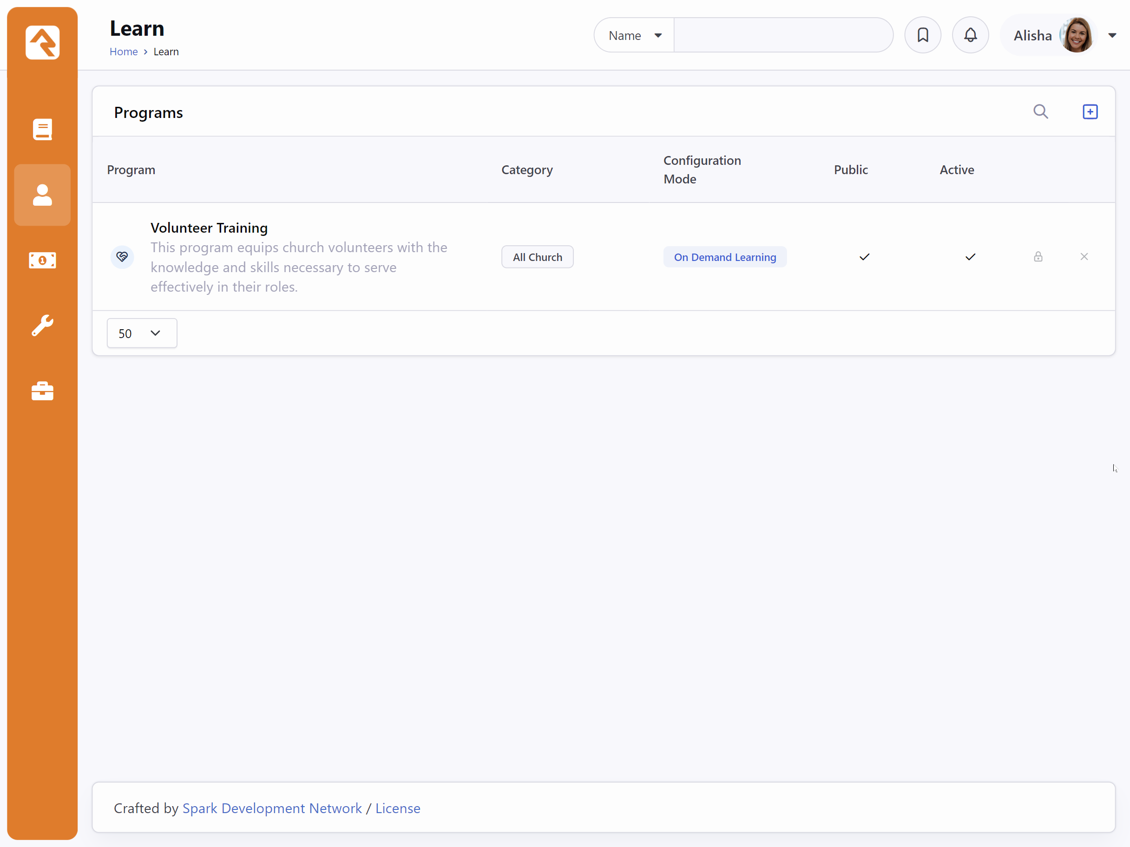
Creating a Learning Program
Navigate to /people/learn
Program list view

Slide 7
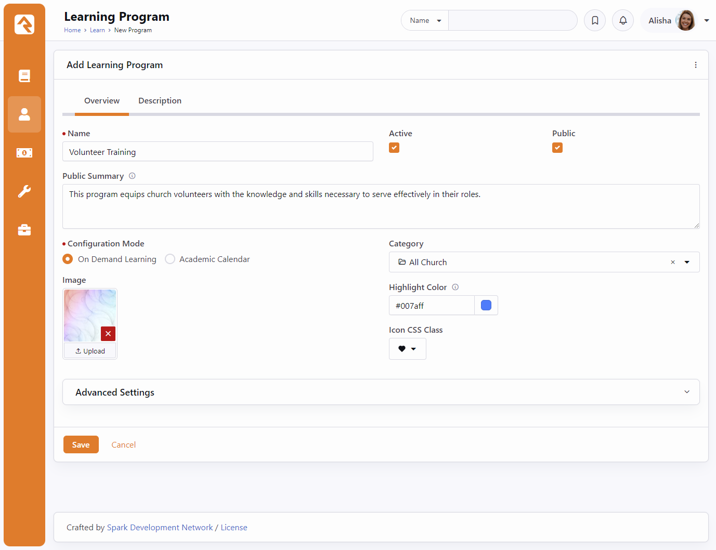
Creating a Learning Program
Learning Program Detail Block
Configure your Learning Program to be active and public
Select a Configuration Mode
Notes:
Public adds it to the Public Learning Hub

Slide 8
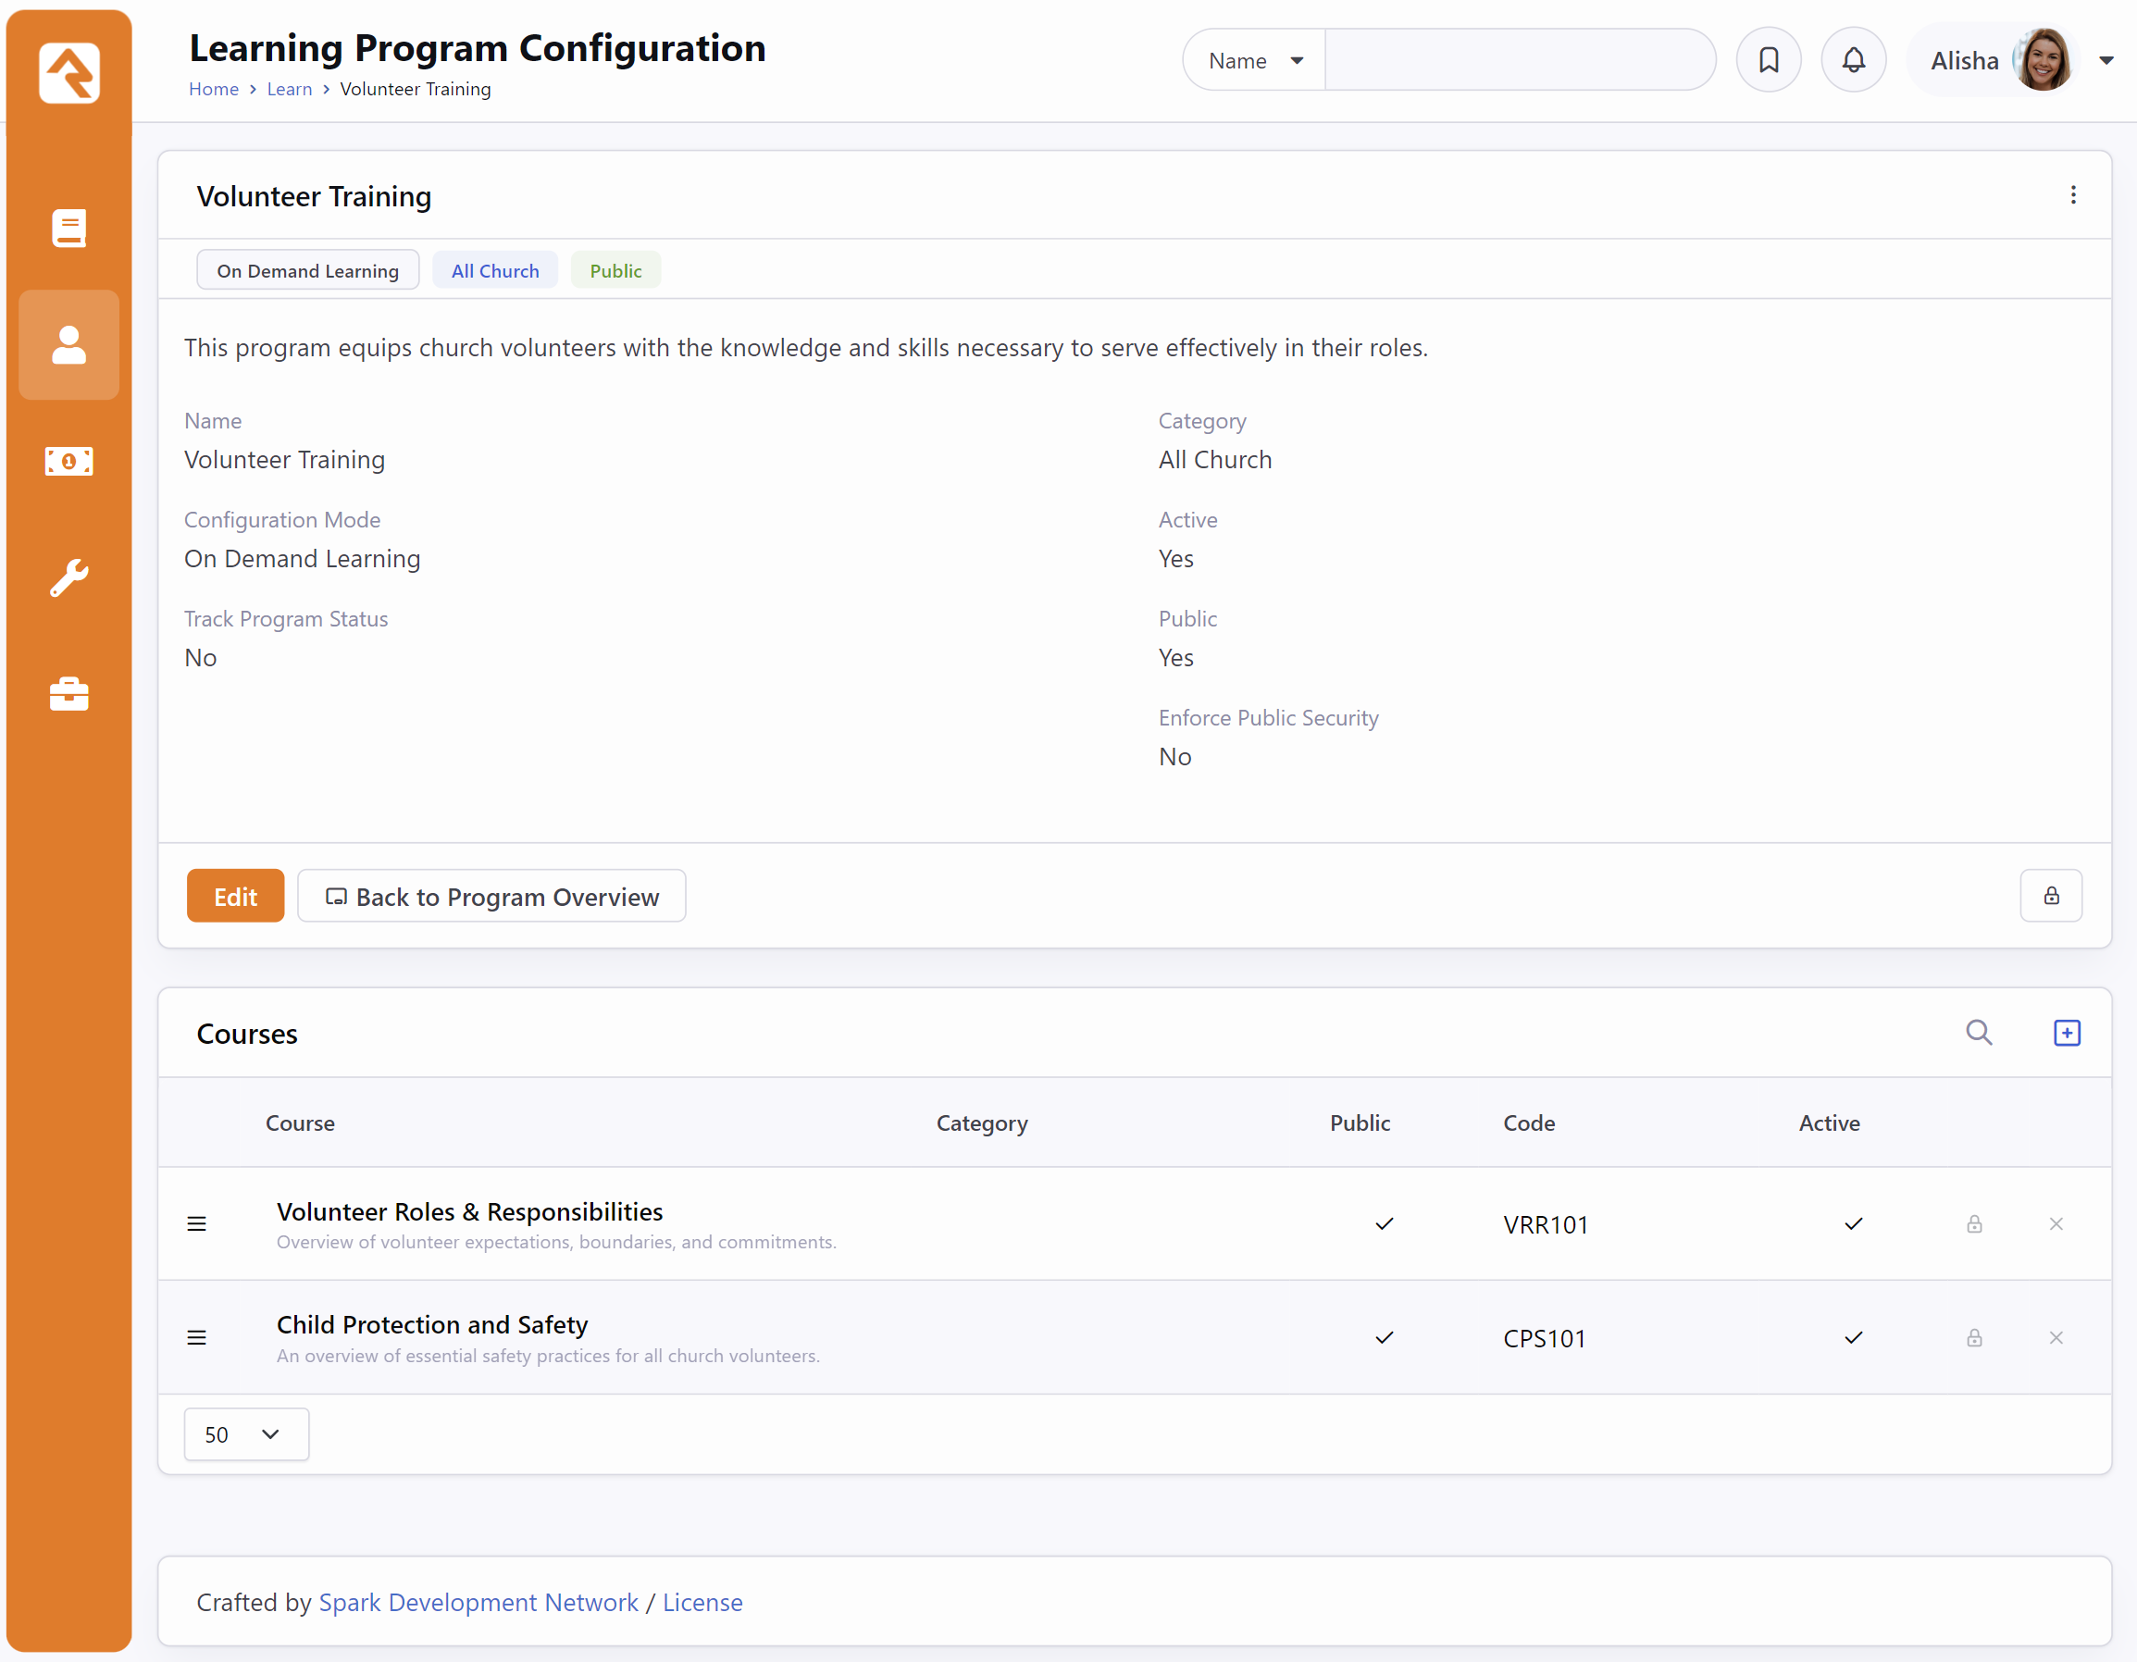
Add a Course
Program Configuration View
Displayed Course List used to add new courses or edit existing ones.

Slide 9
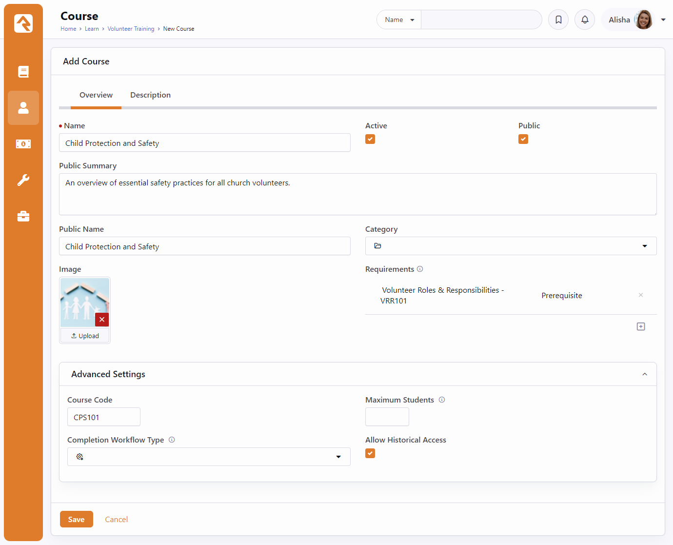
Add a Course
Course Detail Block
Set pre-requisit or equivelant requirements.
Add a course code
Set a maximum amount of students
Select a completion workflow
Enable access to course content after an individual has completed it. (Allow Historical Access)

Slide 10
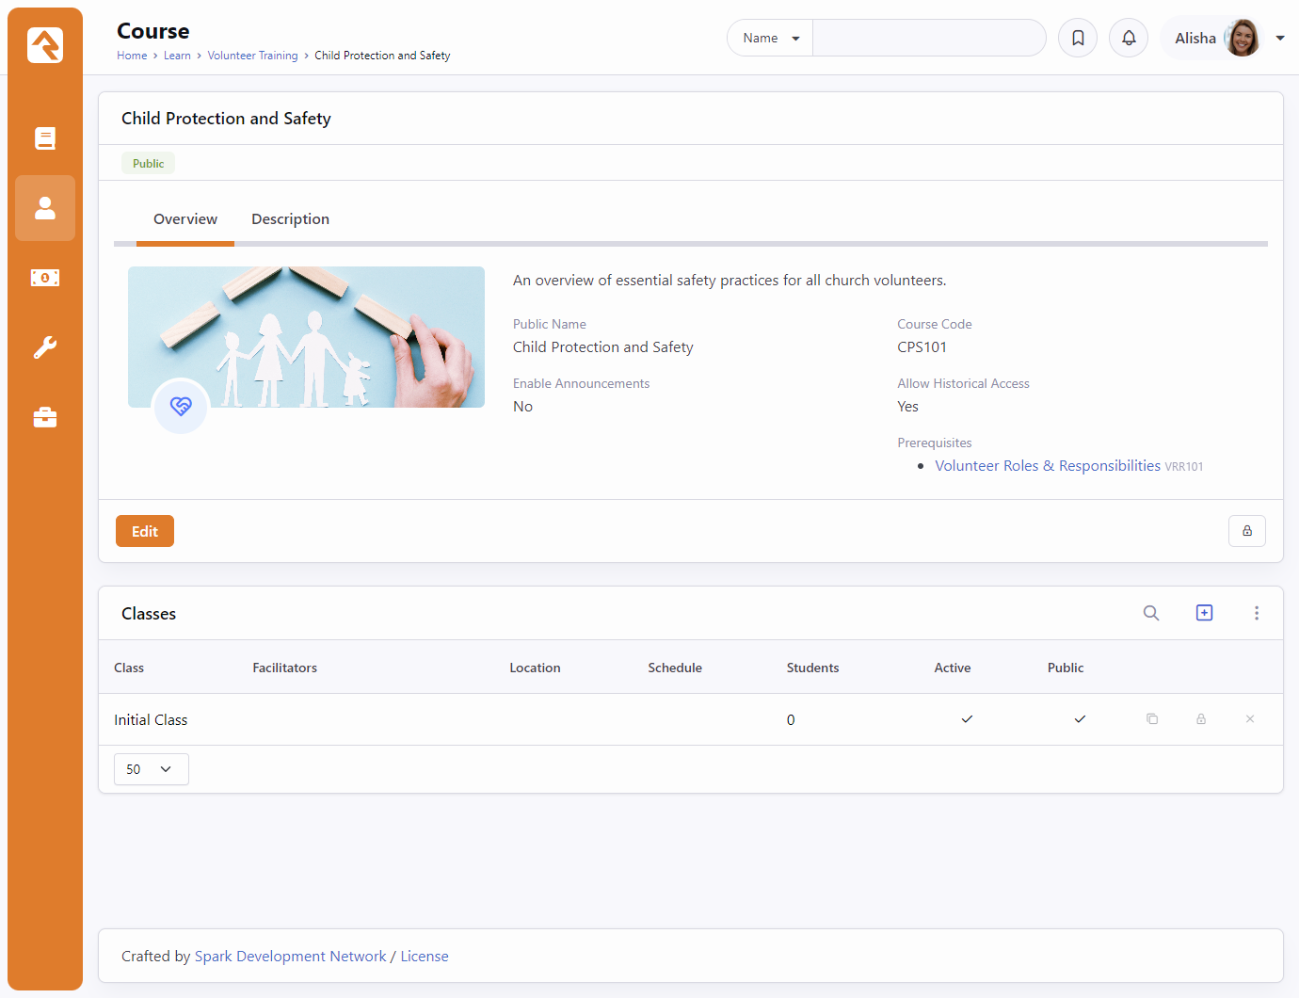
Configure the Class
Course Detail View
Edit Initial Class
Copy an existing class

Slide 11
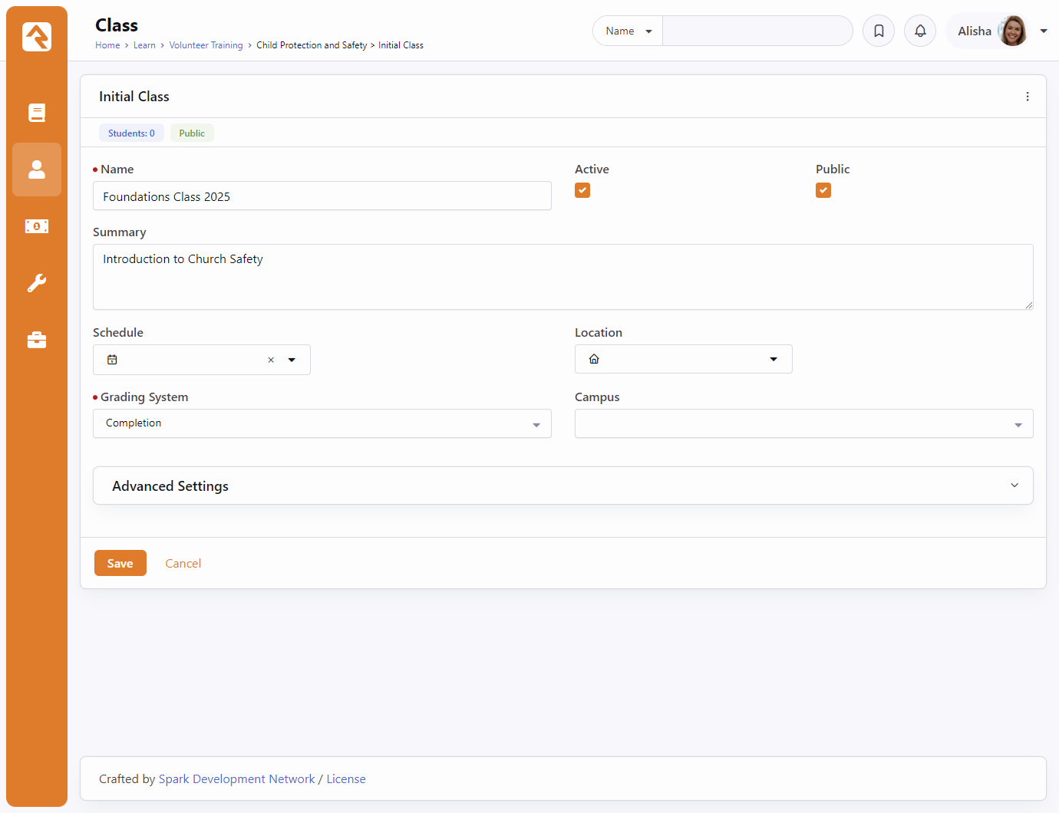
Configure the Class
Class Detail Block
Select a Grading System

Slide 12
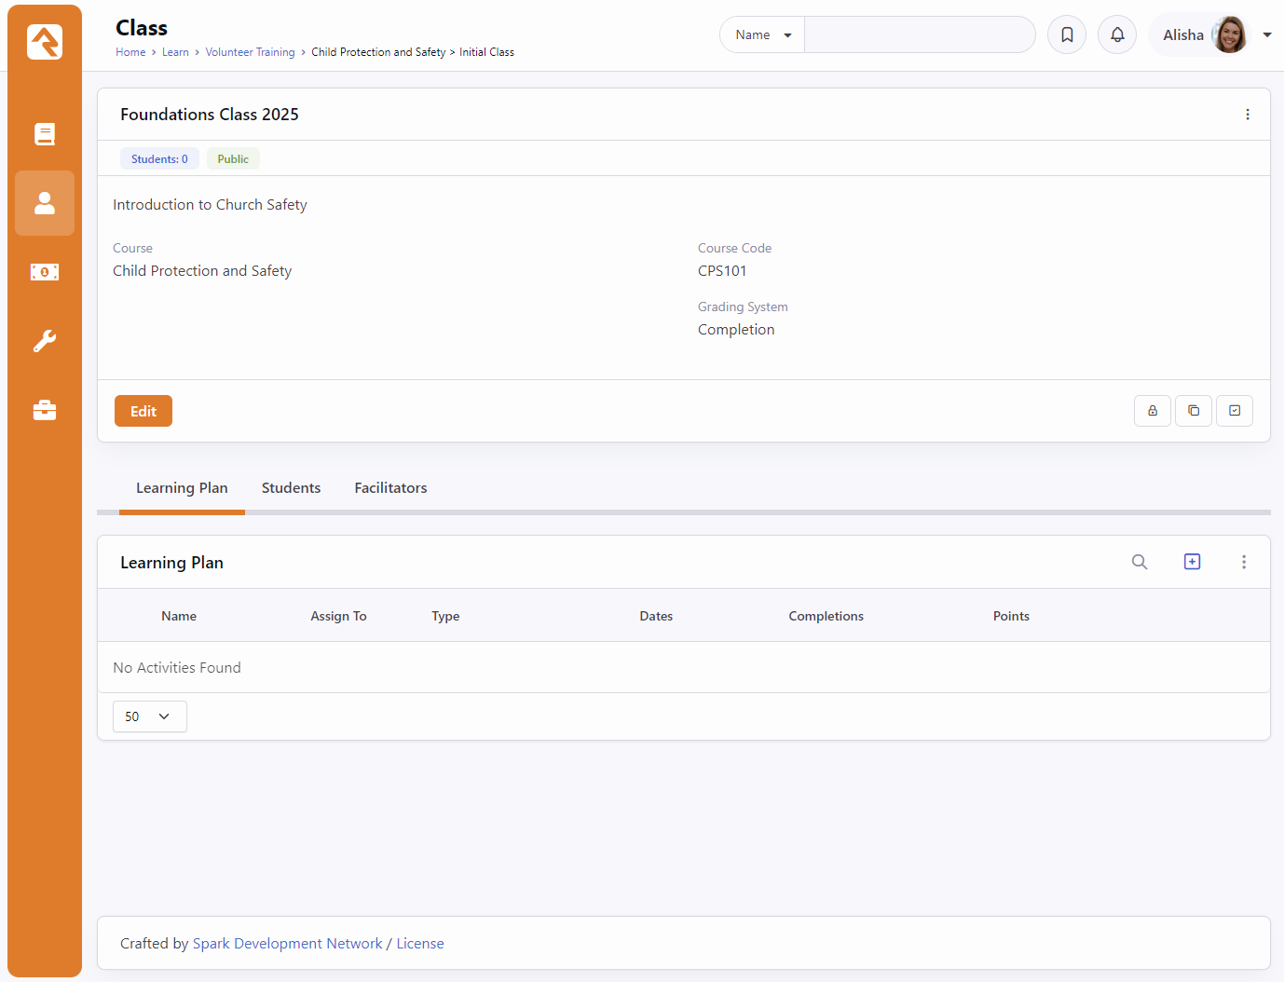
Build the Learning Plan
Class Detail View
Copy existing class
Configuration for Learning Plans, Students, and Facilitators

Slide 13
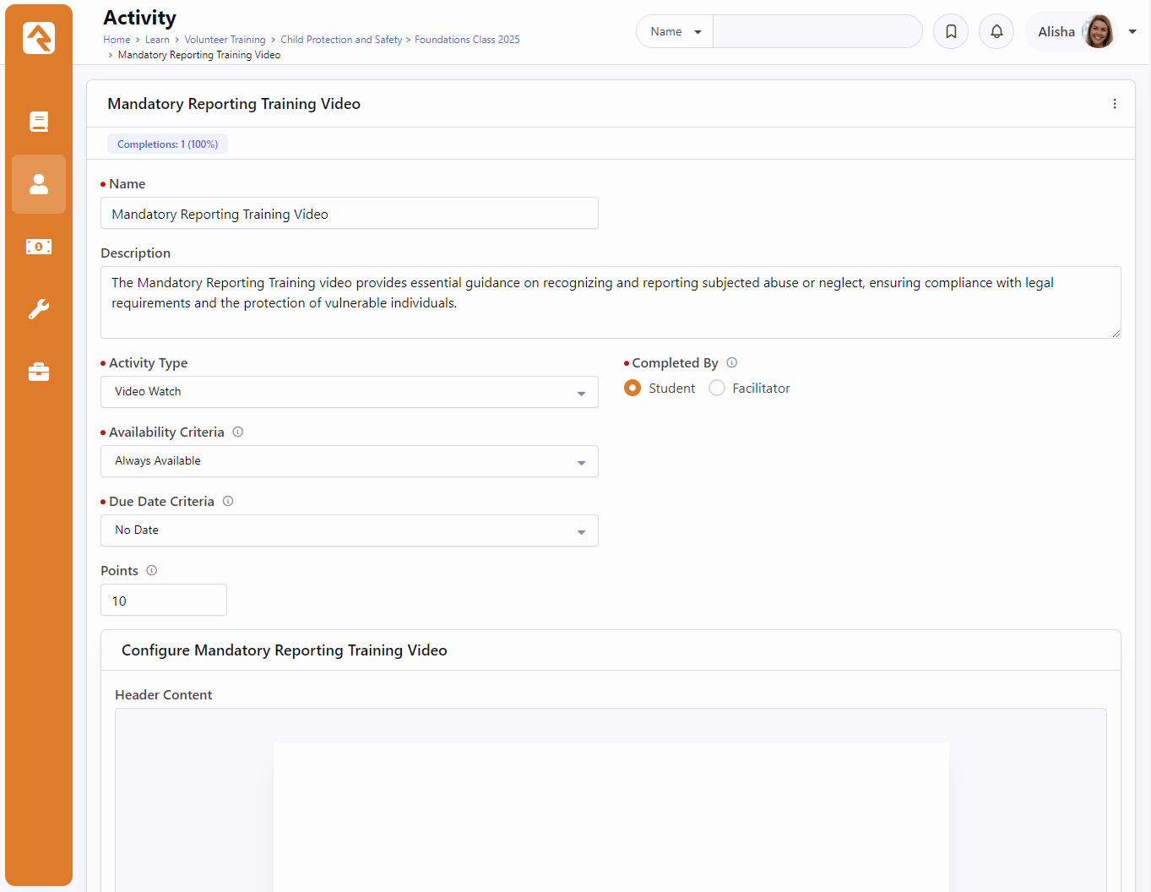
Build the Learning Plan
Learning Activity configuration
Select an Activity Type
Configure availablity and due date criteria
Specific activity configuration

Slide 14
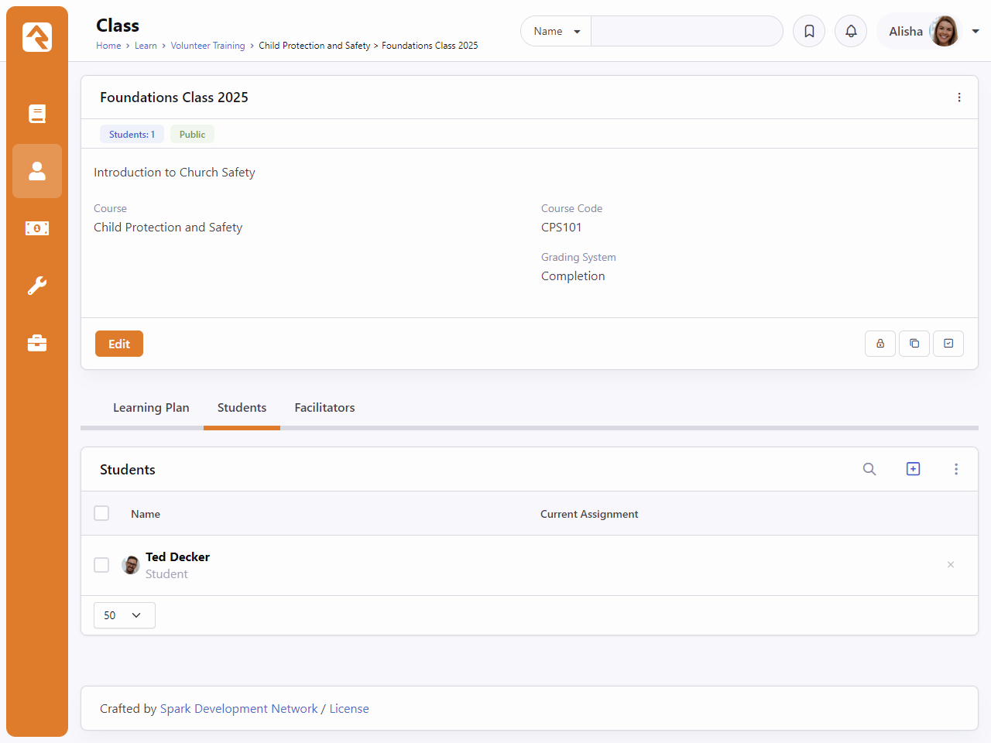
Enroll Students
View list of enrolled students
Remove students from class

Slide 15
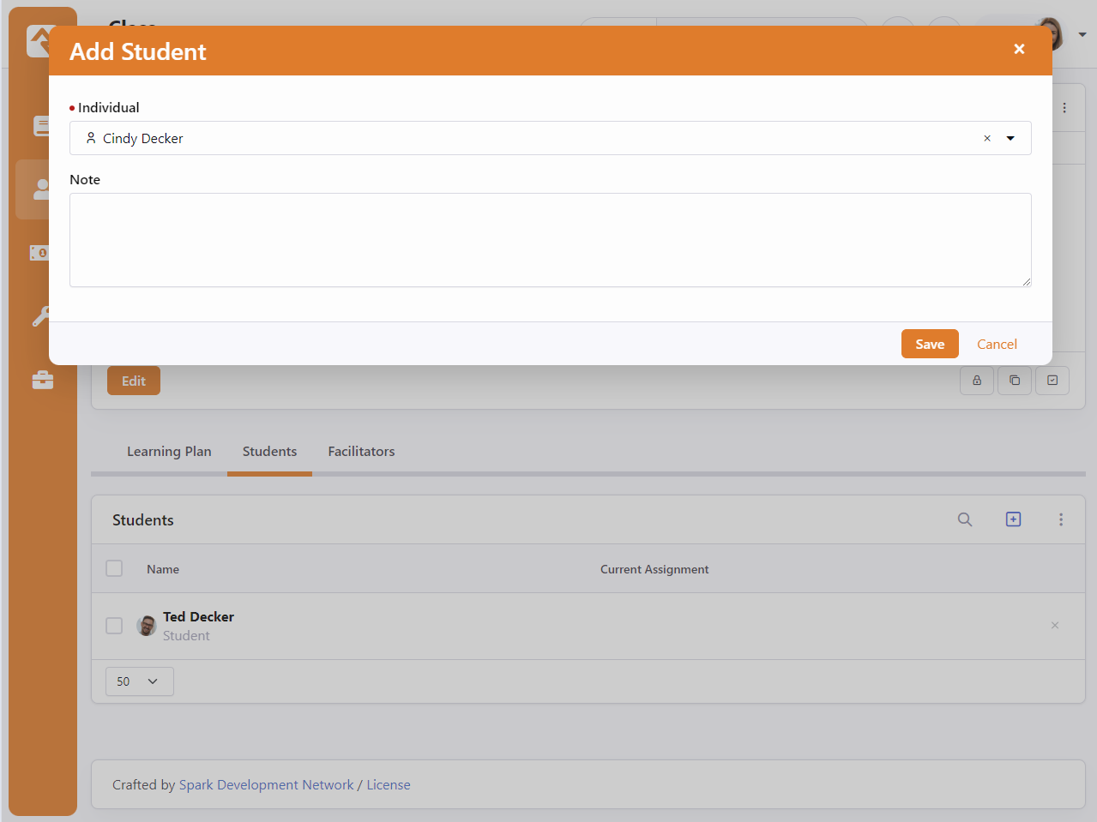
Enroll Students
Enroll a new student
Add an optional note about the student

Slide 16
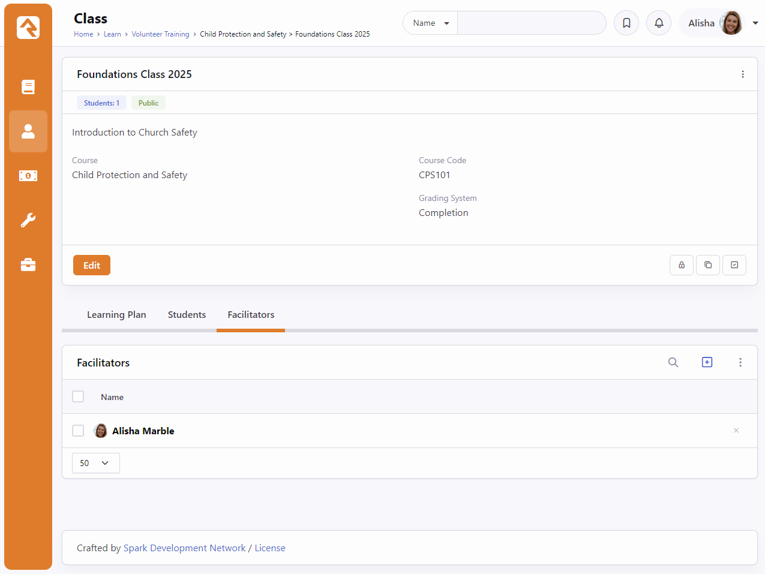
Add Facilitators
View a list of facilitators
Remove existing facilitators

Slide 17
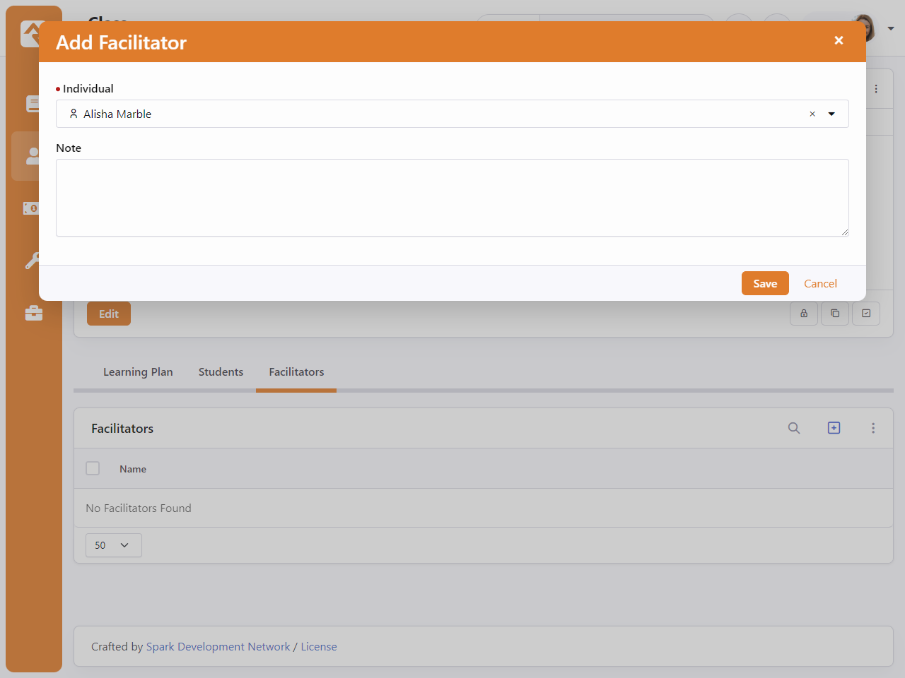
Add Facilitators
Add a new class facilitator
Add an optional note about the facilitator

Slide 18
Learning Hub Preview

Slide 19
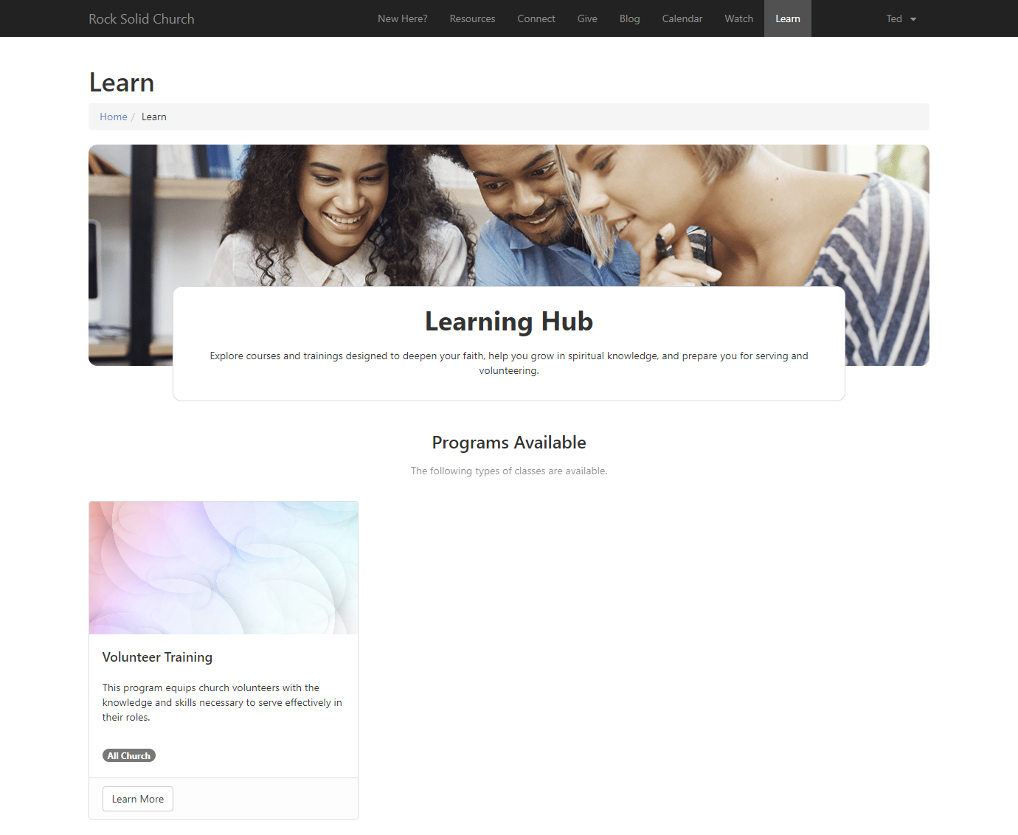
The Learning Hub
The Learning Hub is placed on the public facing site. (/learn)
Lists all public learning programs

Slide 20
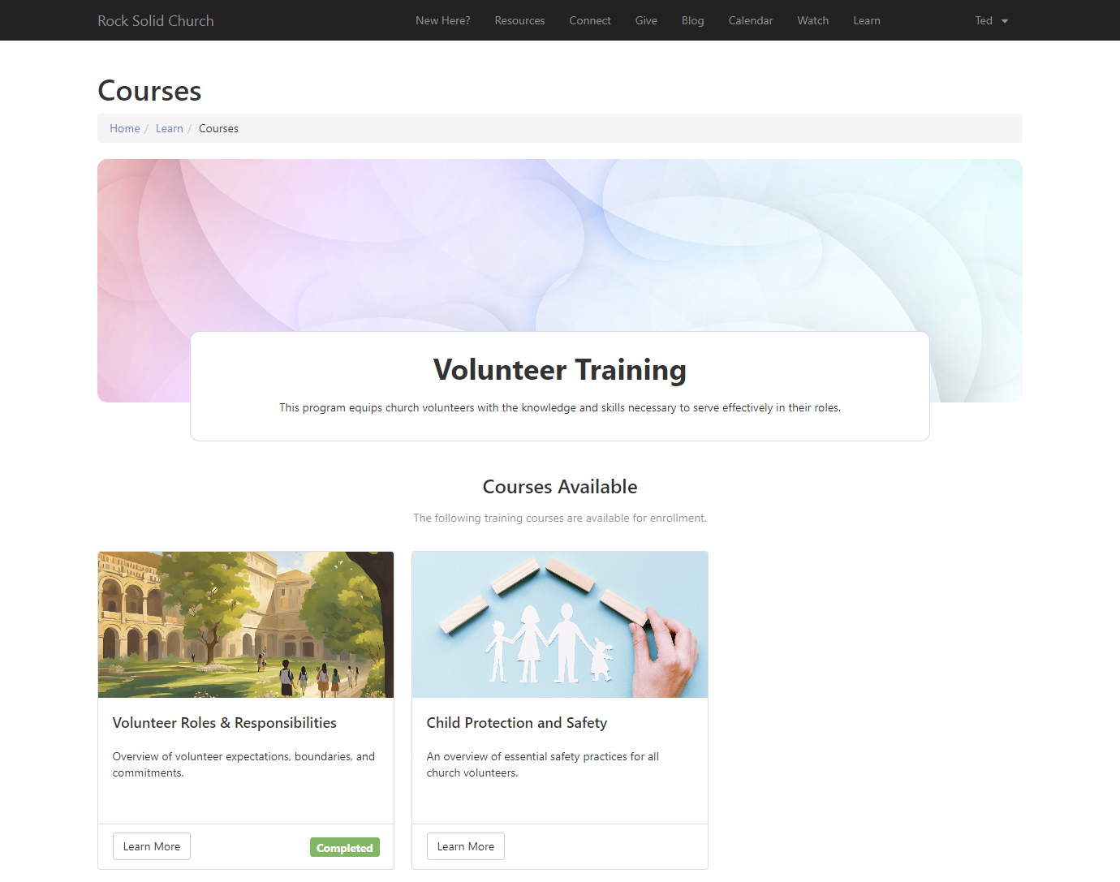
The Learning Hub
Selected Program view
Lists all available courses

Slide 21
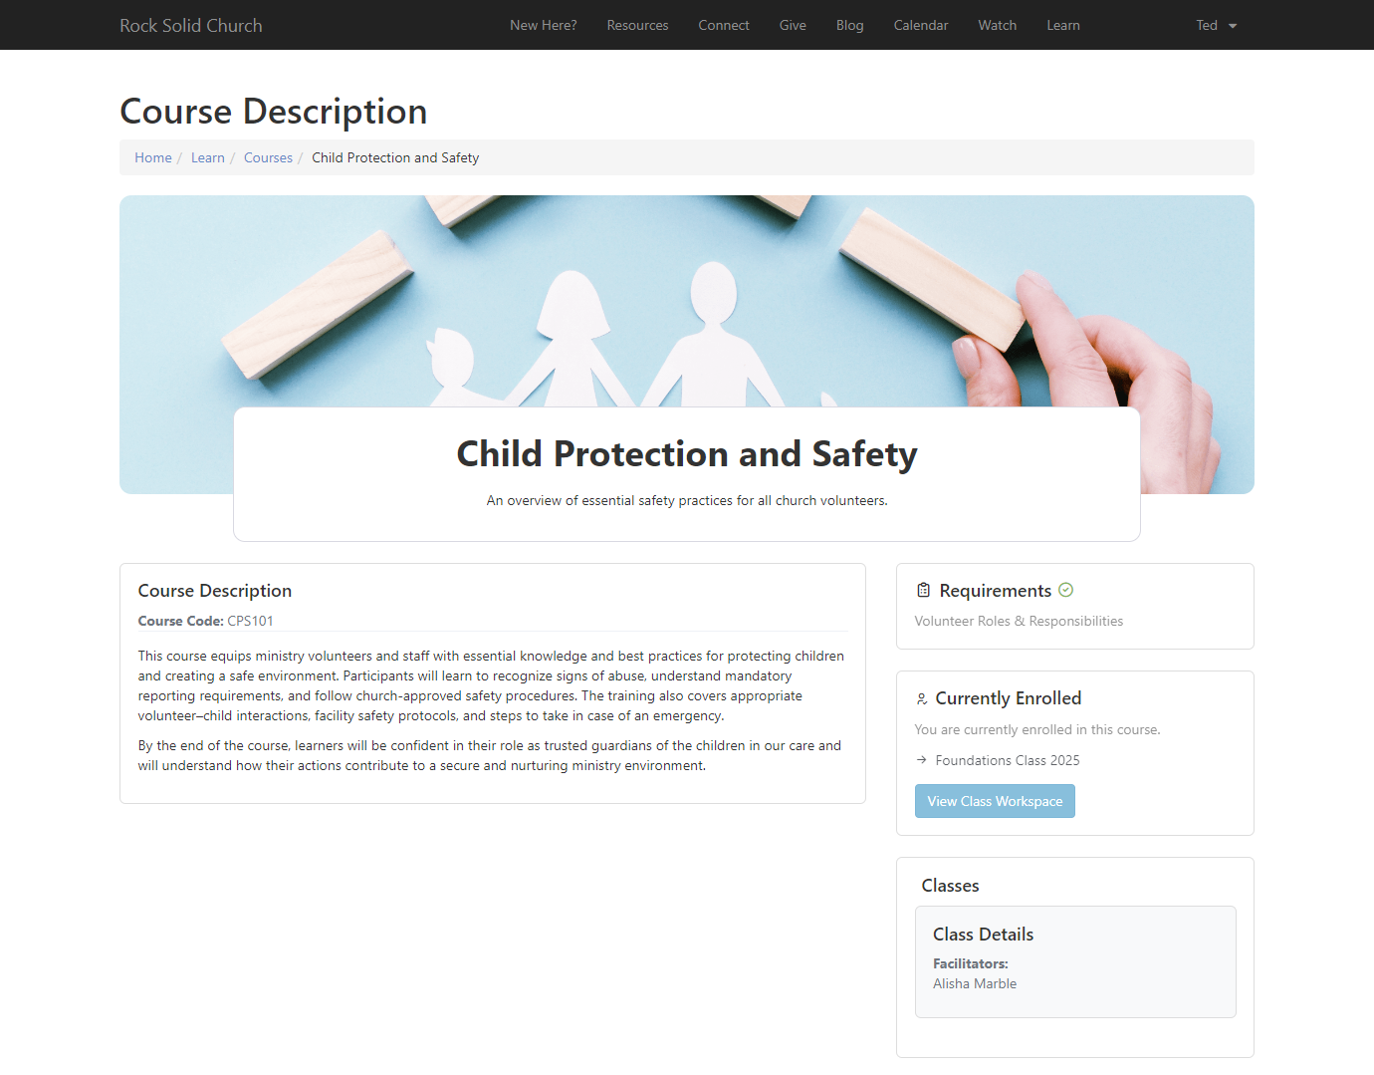
The Learning Hub
Selected course view
Displays course code and description
Course requirements and class facilitators are shown
Select "View Class Workspace" to get to work on class activities

Slide 22
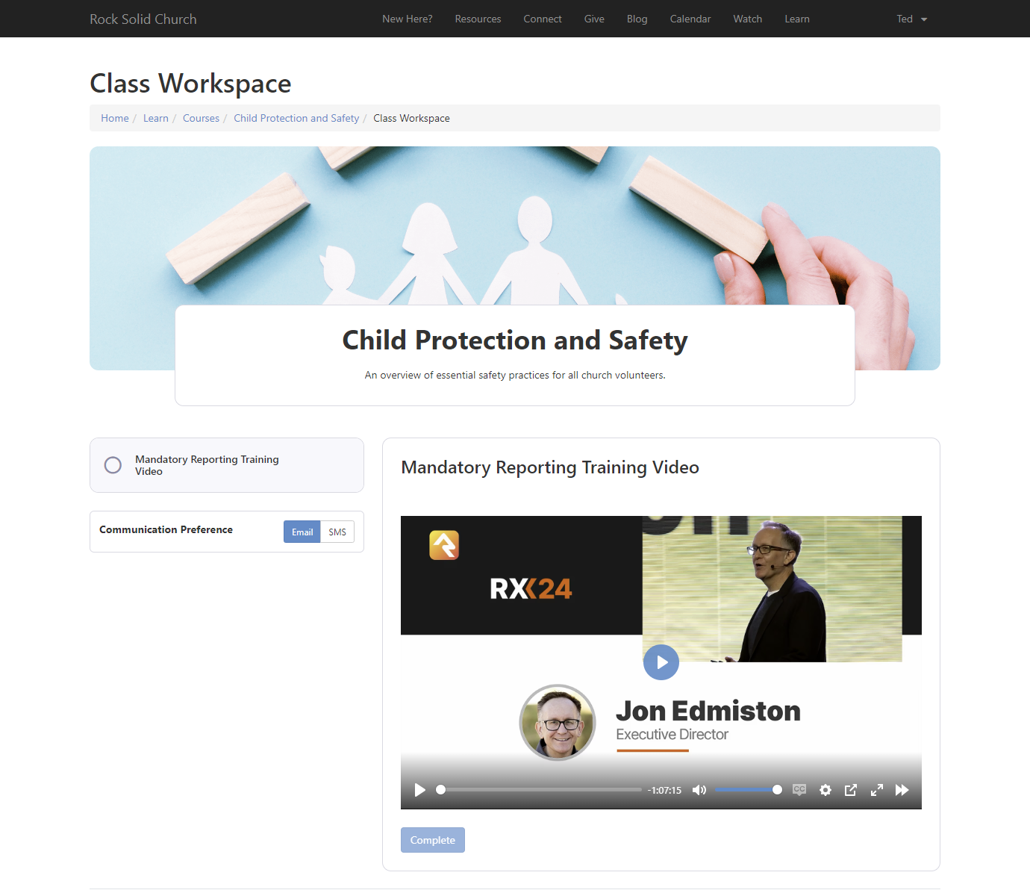
The Learning Hub
Available class activity view

Slide 23
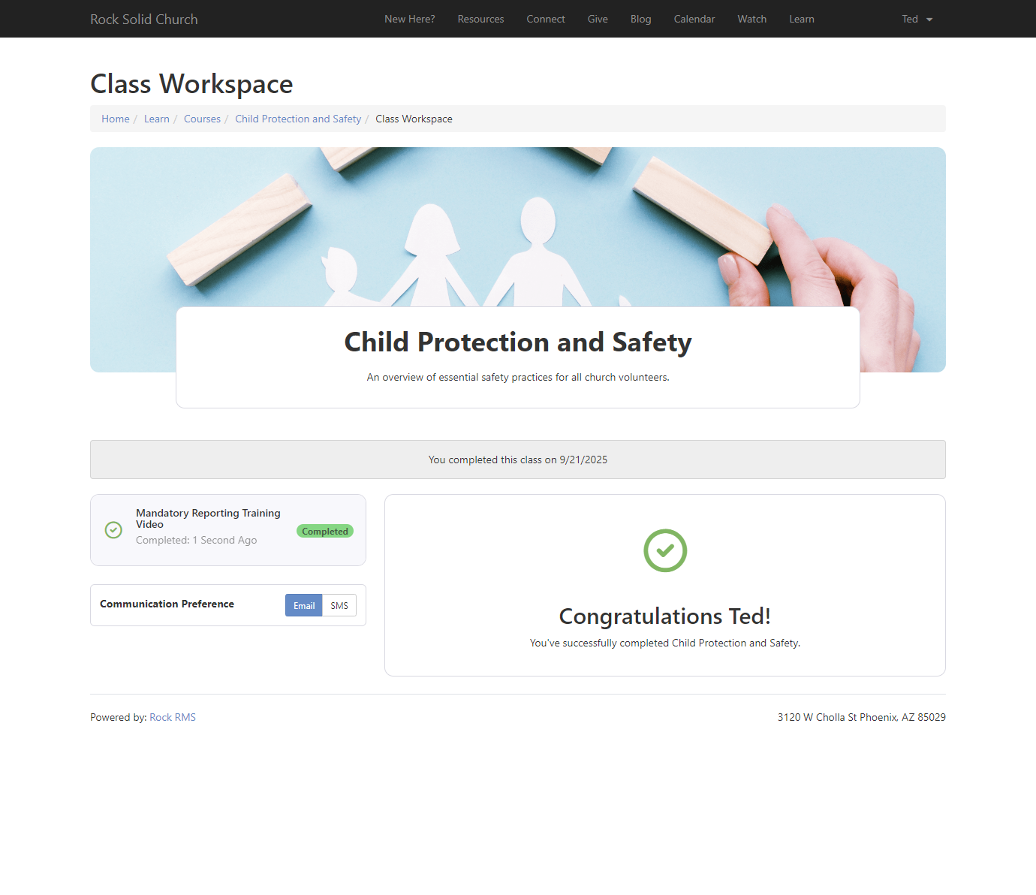
The Learning Hub
Completed class view

Slide 24
Learning Plan Activity Types

Slide 25
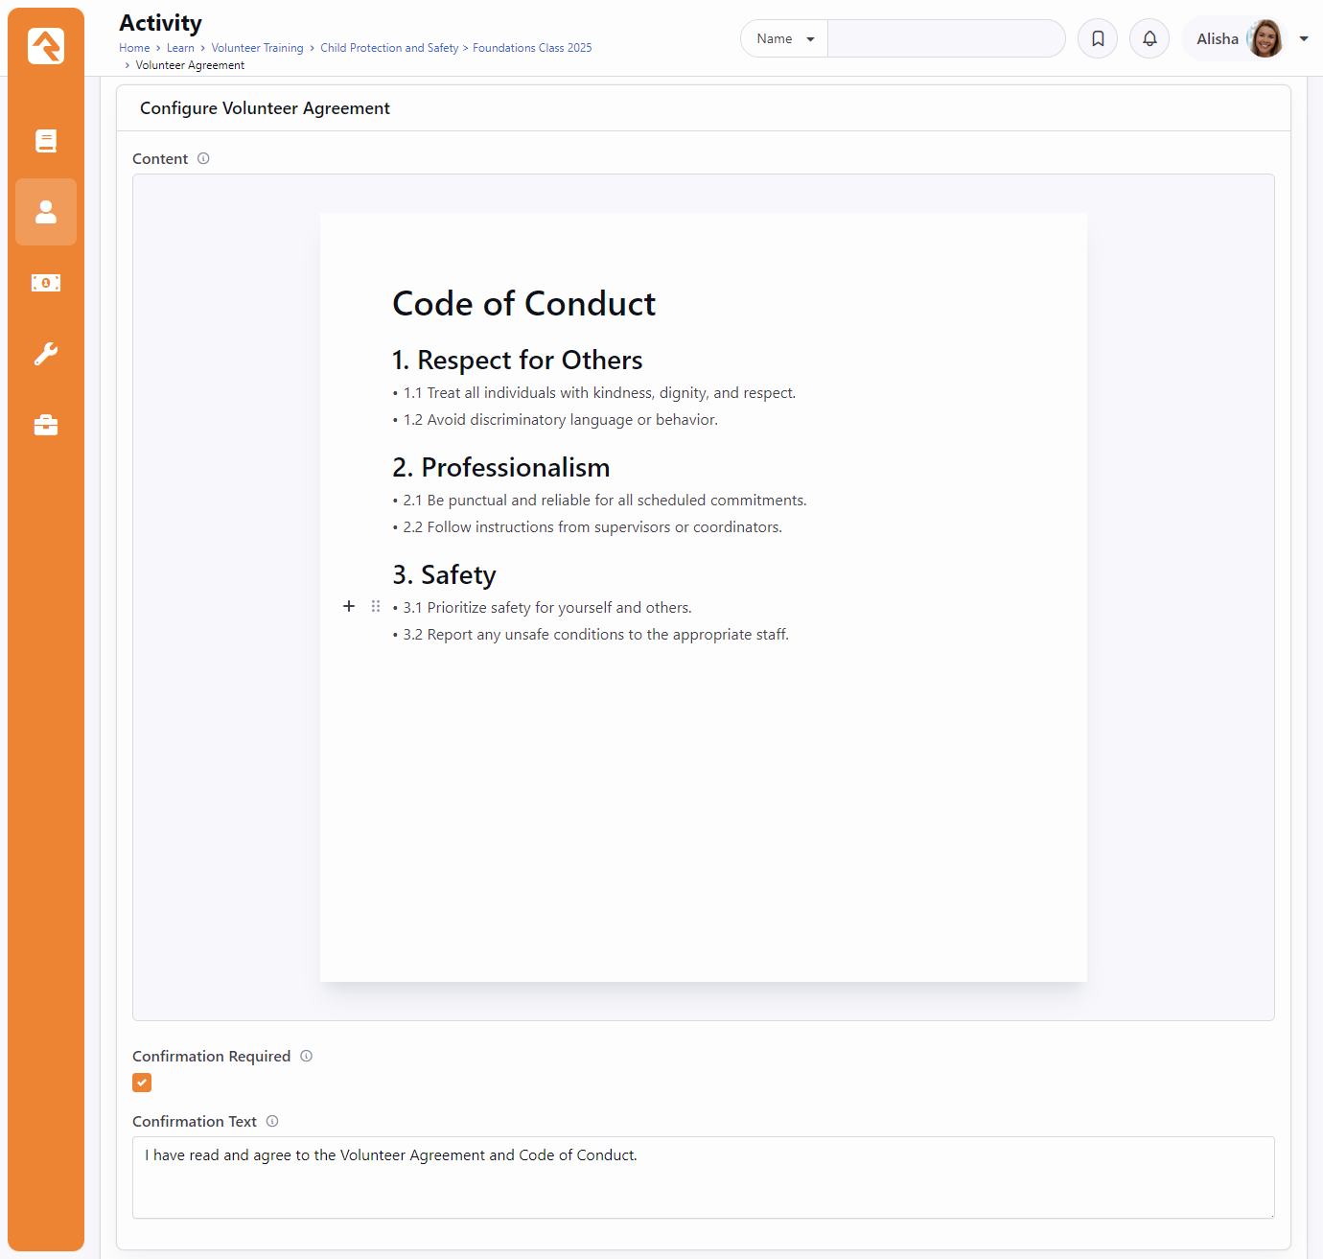
Acknowledgment
Add structured content for the individual to read before acknowledging. (Lava enabled)
Select the “Confirmation Required” checkbox to display a confirmation check box.
Add optional confirmation text
Notes:
Common Lava merge fields accepted for Content.
Confirmation text will not display if “Confirmation Required” is not checked

Slide 26
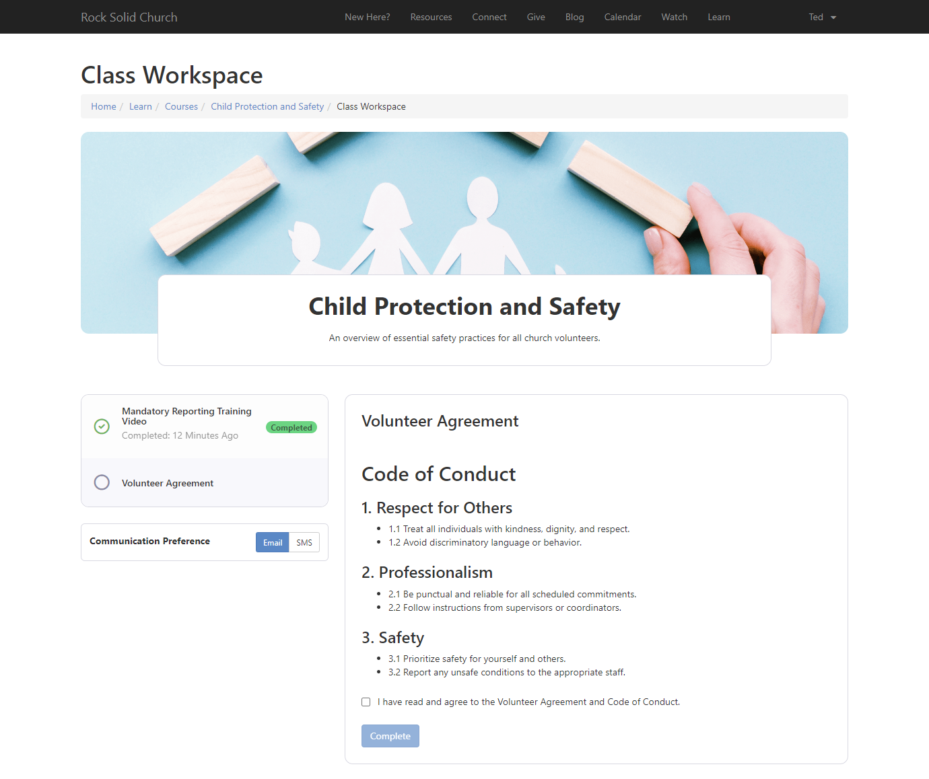
Acknowledgment (Student View)
Complete button is disabled until the confirmation check box is checked.

Slide 27
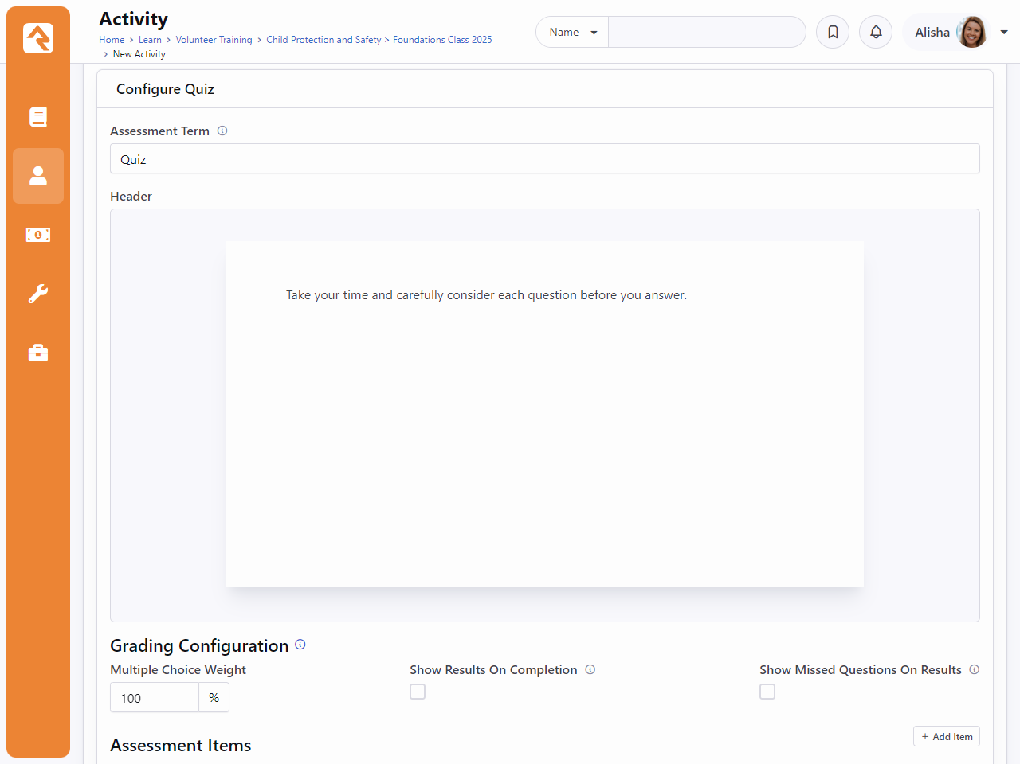
Assessment
Add a simple Assessment Term. (Quiz, Test, etc.)
Header content to display at the top of the assessment.
Grading Configuration
  Multiple Choice Weight: The percentage of the total score attributed to Multiple Choice questions.
  Show Results on Completion: Displays the student’s results after they complete the assessment.
  Show Missed Questions on Results: Displays missed questions in the result summary that displays on completion.

Slide 28
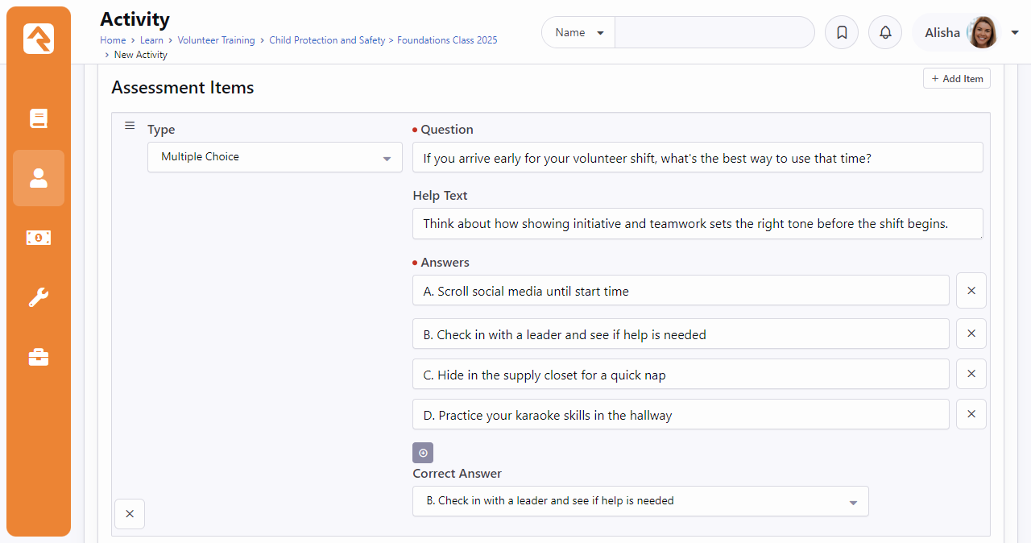
Assessment (Multiple Choice)
Help text is optional.
There can only be one correct answer.
Click the + button to add more answer choices.

Slide 29
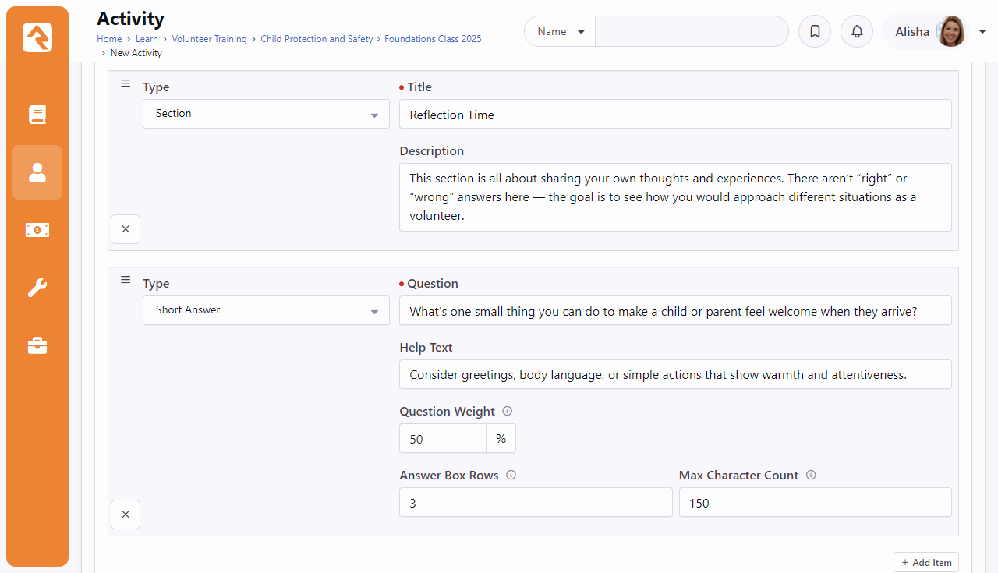
Assessment (Section/Short Answer)
Add a Question Weight for each short answer question
Add a max character count for the student’s short answer

Slide 30
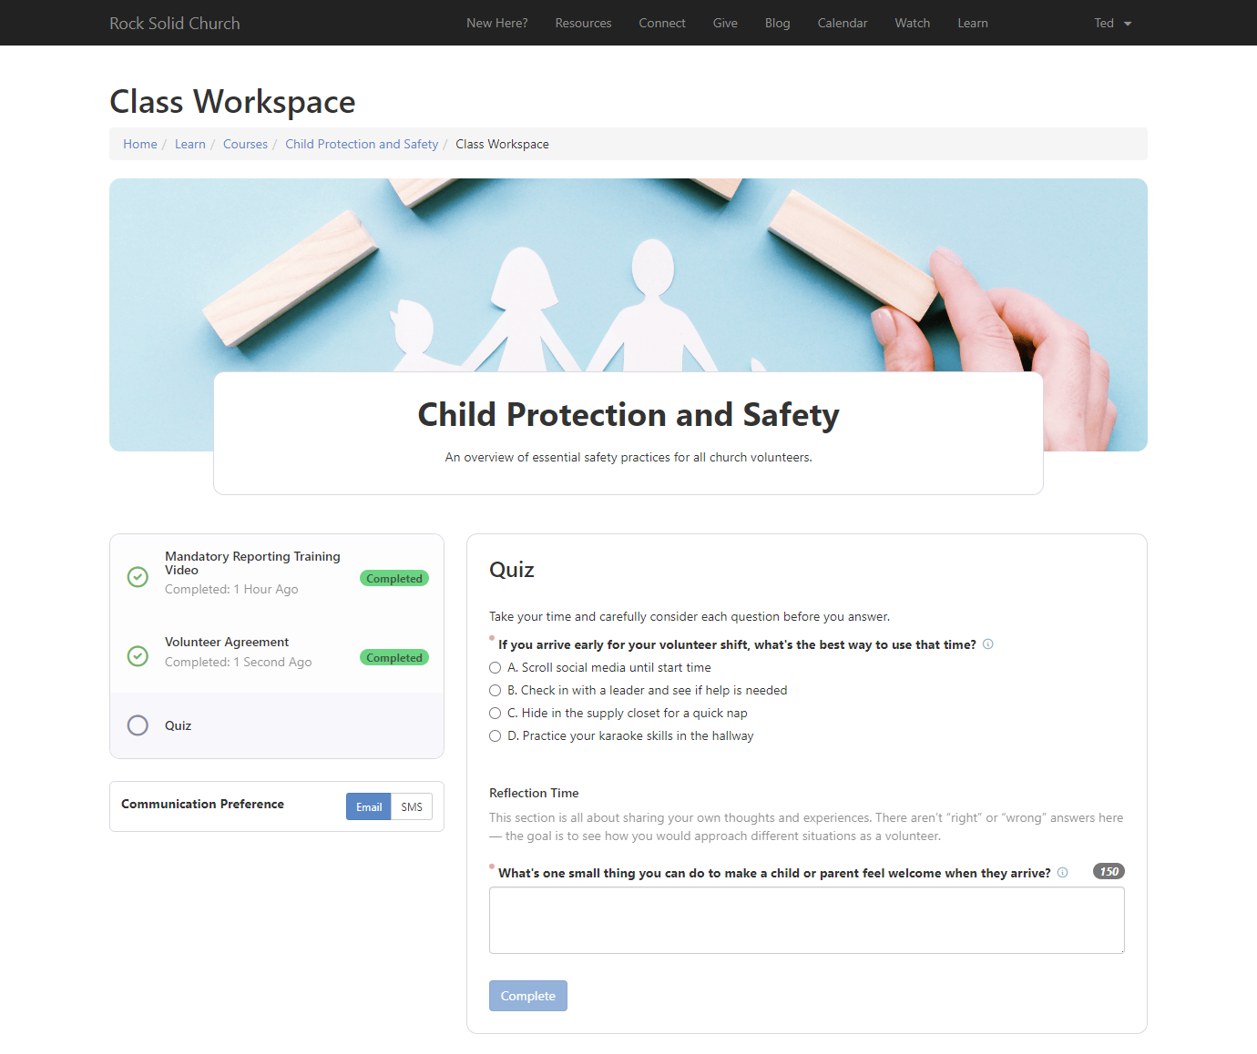
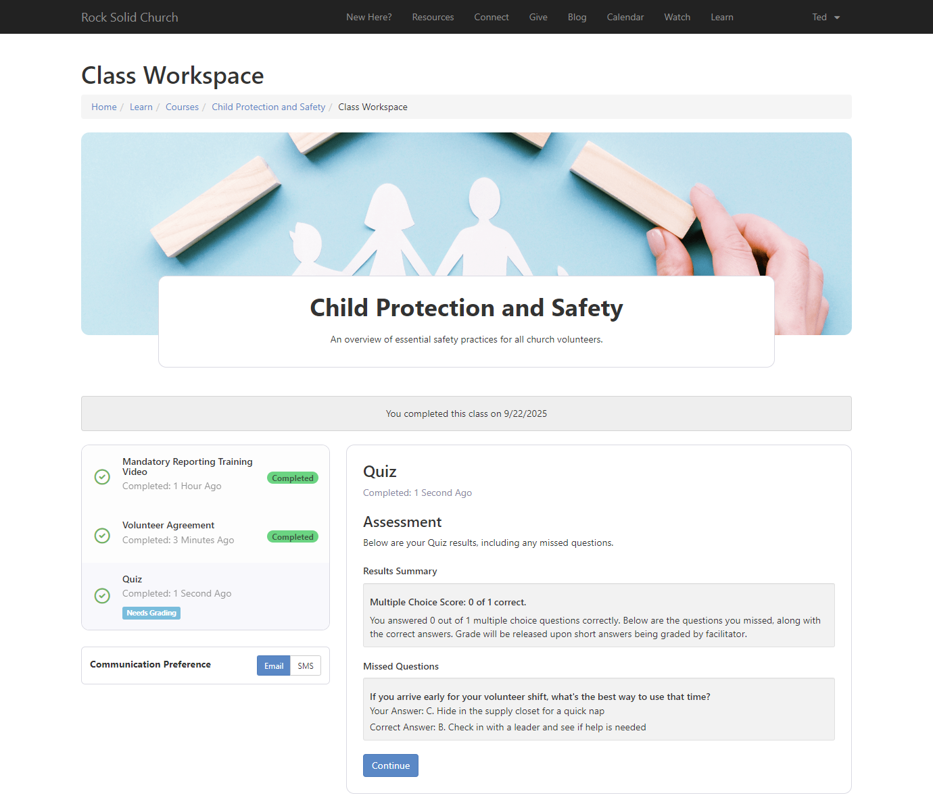
Assessment (Student View)
Notes:
Active quiz -> completed quiz
Quiz needs grading
Shows amount correct, along with missed questions.

Slide 31
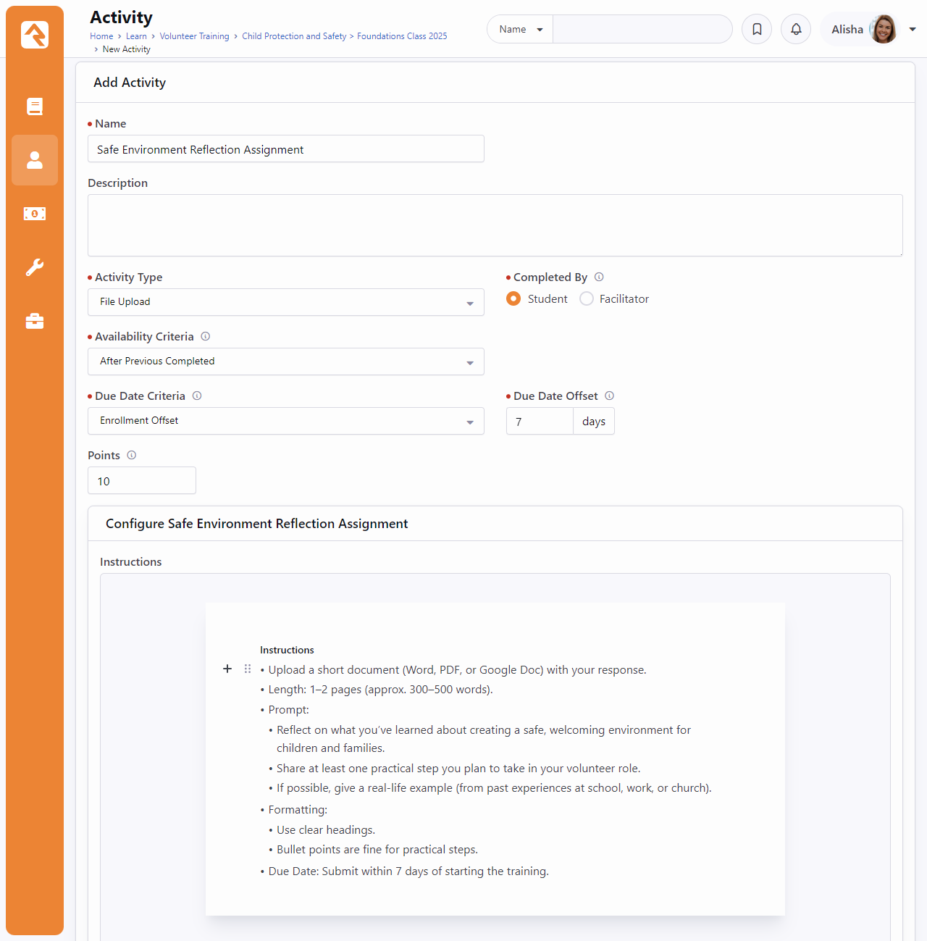
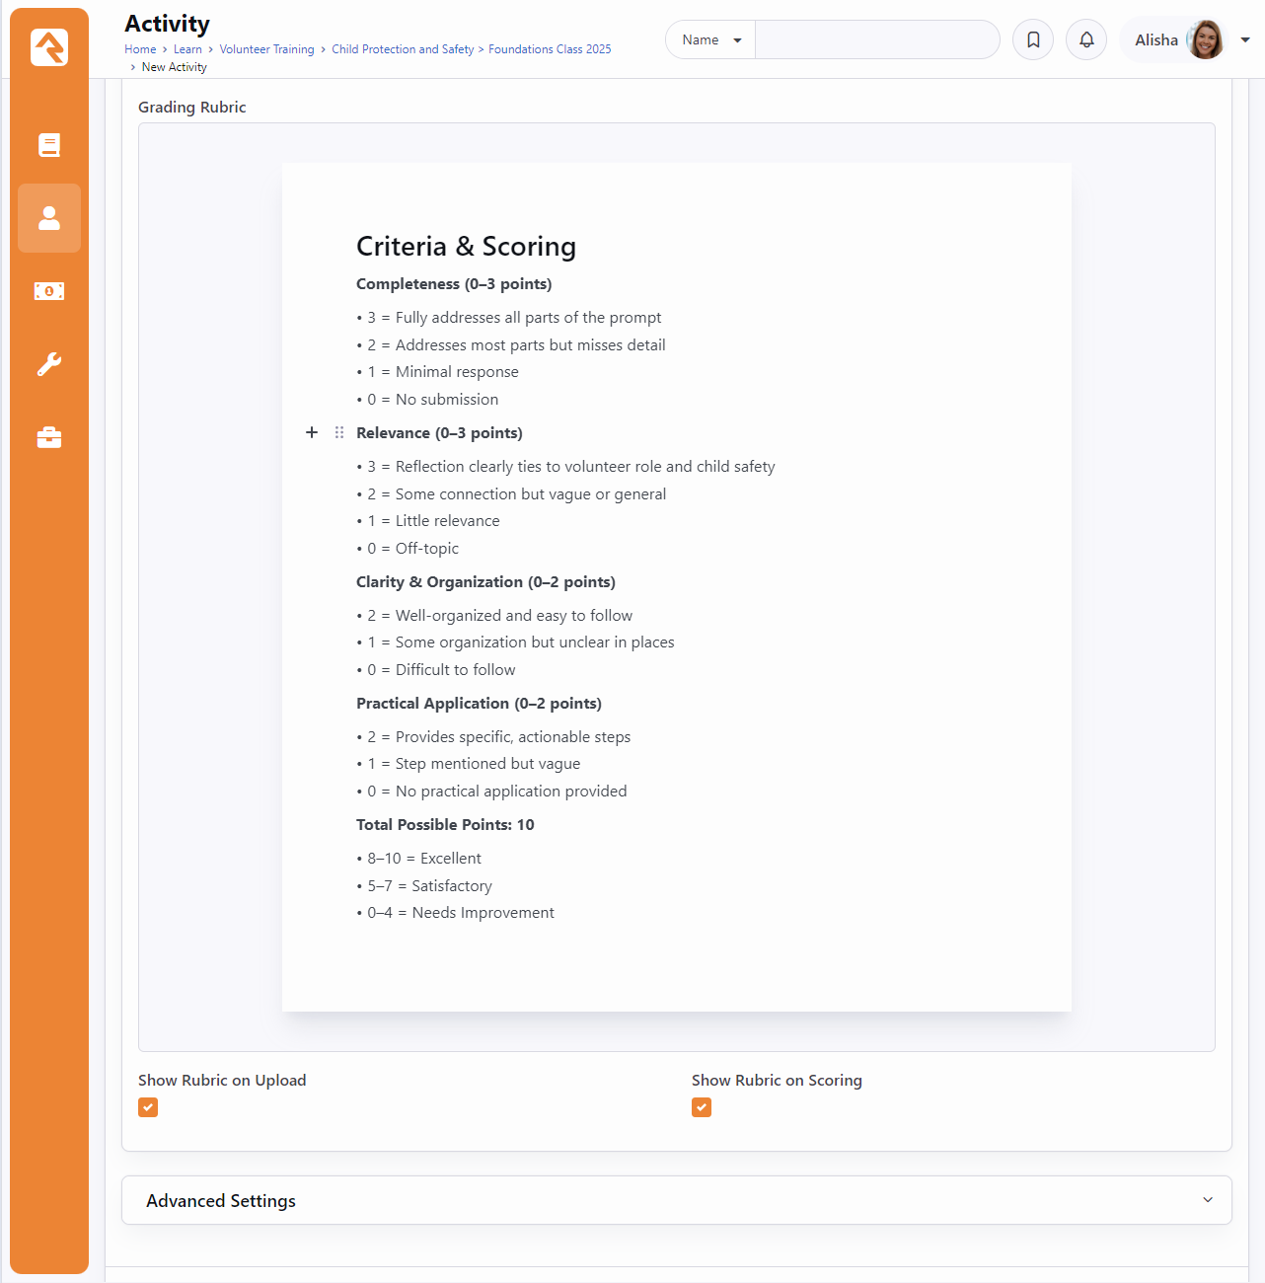
File Upload
Notes:
Structured Content for Instructions and Grading Rubric
Checkboxes for showing rubric on upload and showing rubric on scoring

Slide 32
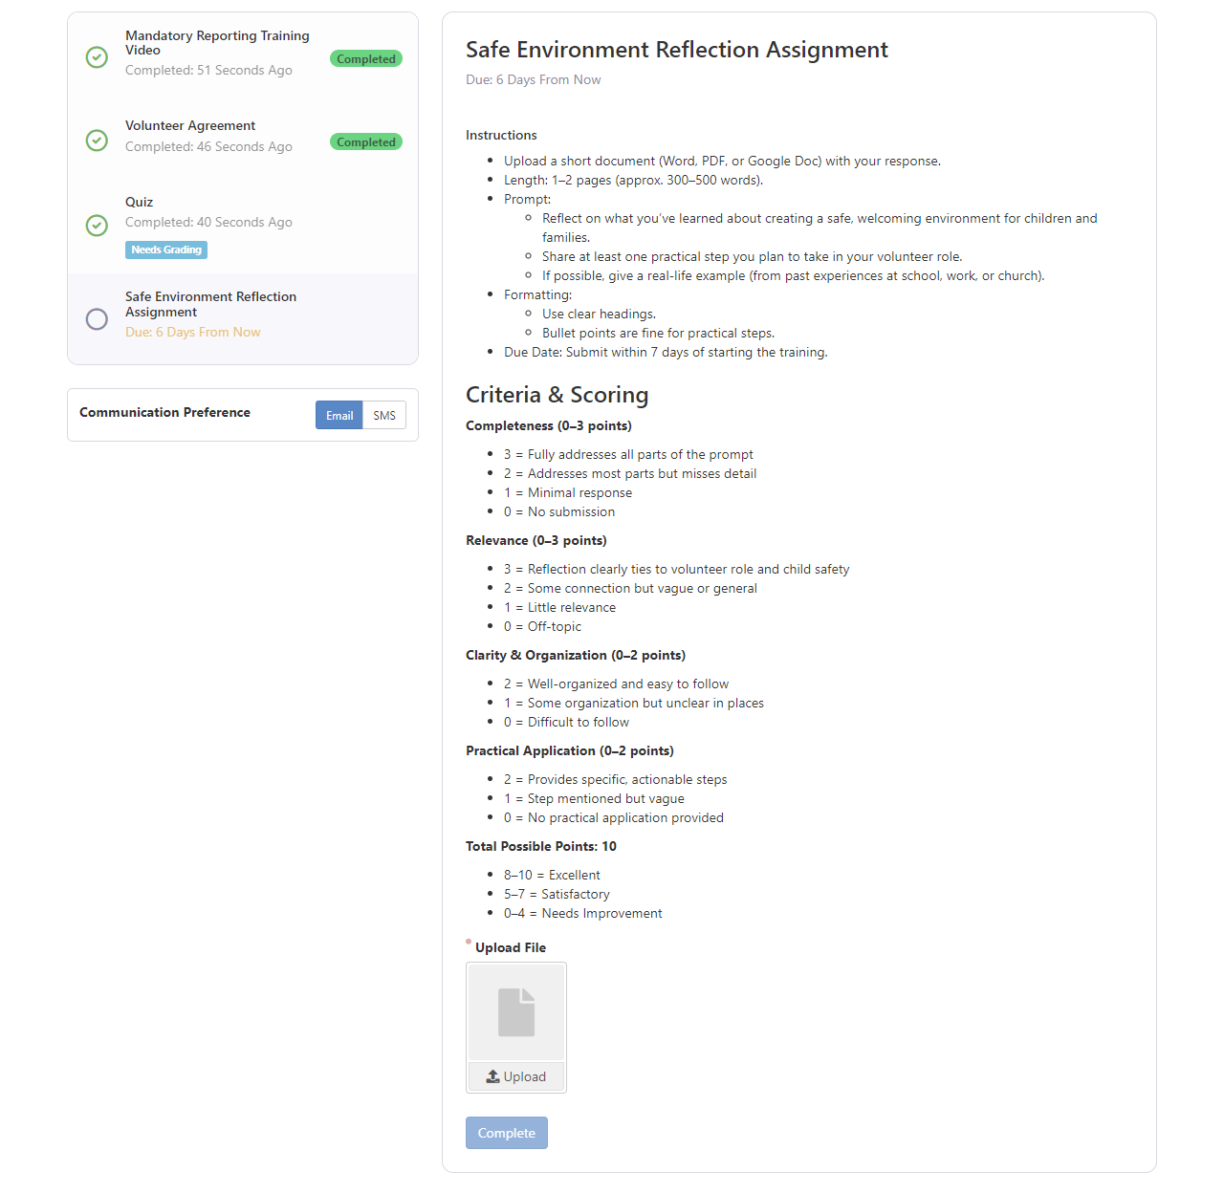
File Upload (Student View)
Instructions and grading rubric are displayed
Upload file, click Complete, and wait for your submission to be graded by a class facilitator

Slide 33
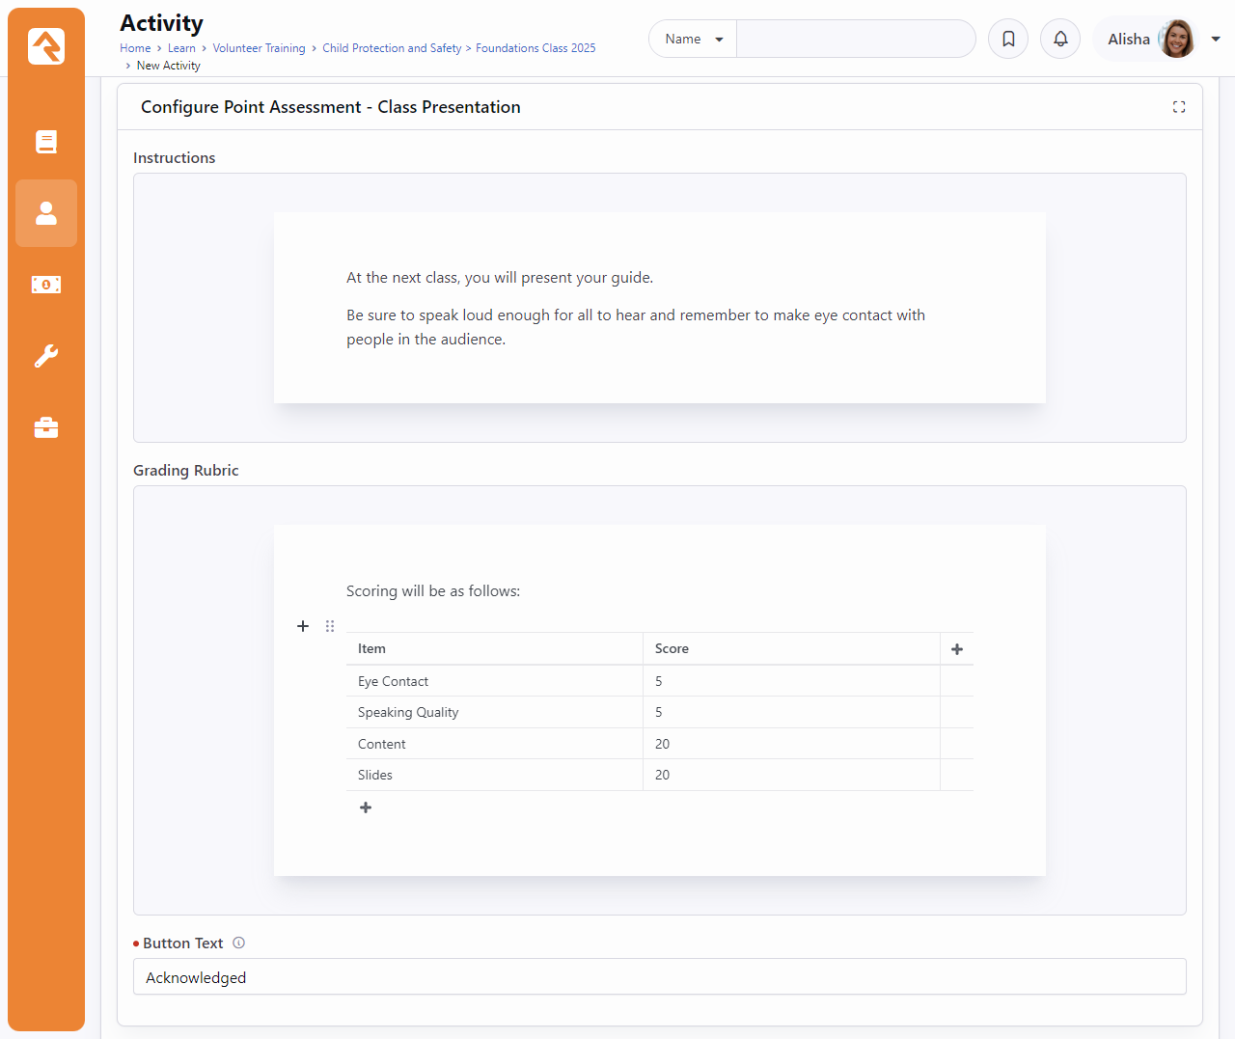
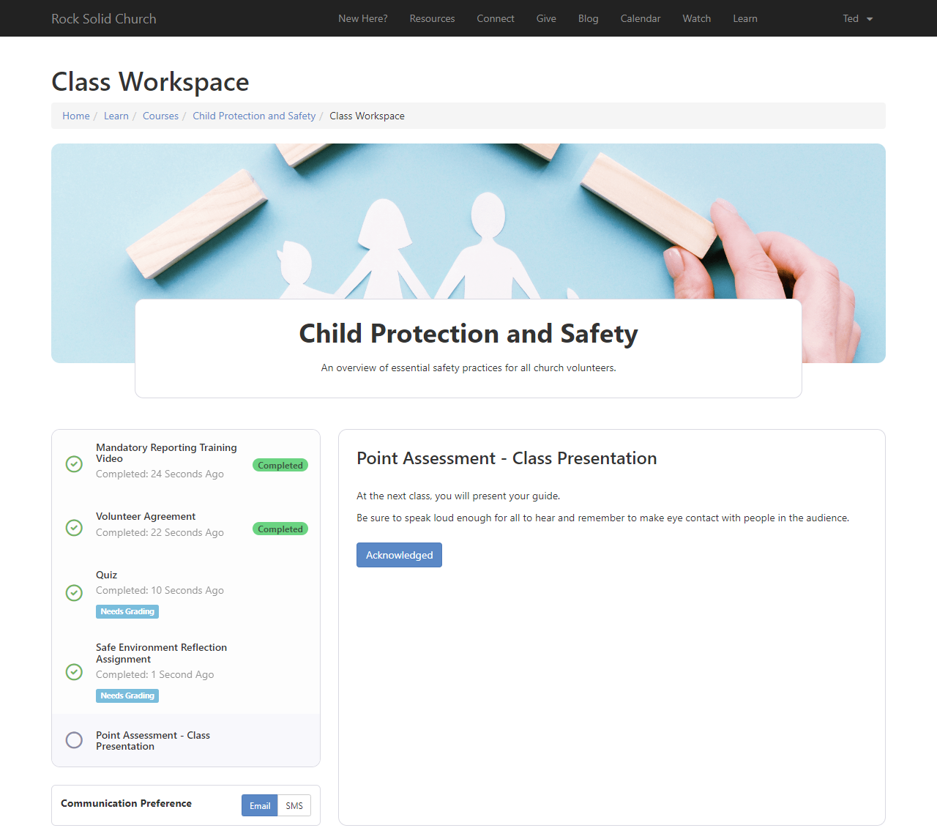
Point Assessment
Notes:
The Point Assessment activity is similar to the File Upload activity, but students do not upload anything. It is ideal for scenarios where students present something physical or deliver an in-person presentation.
Here, the grading rubric is intended as a guide for facilitators, helping them stay on track with the rules and criteria for grading the assignment.

Slide 34
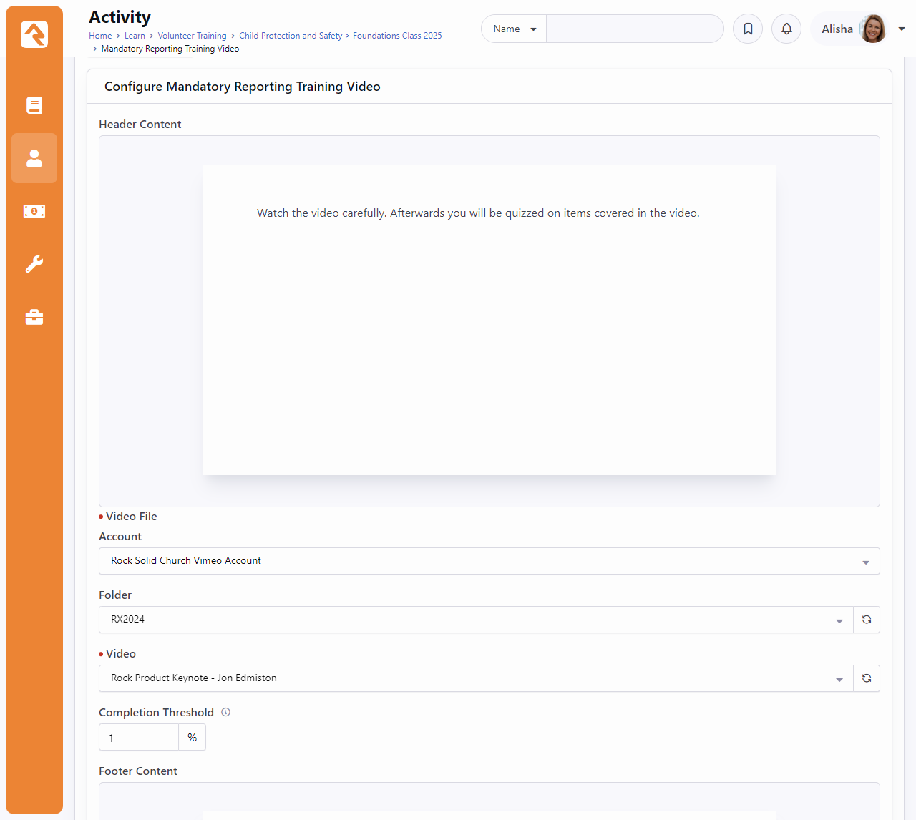
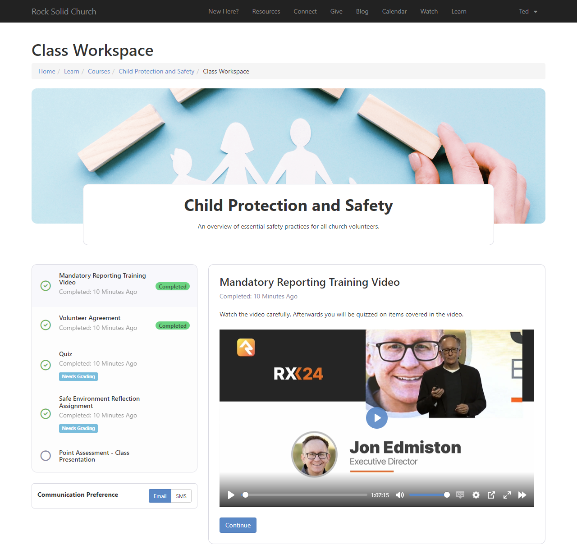
Video Watch
Notes:
Let’s you share a video from your Digital Media Accounts in Rock. You can set how much of the video a student needs to watch before they can mark it as completed.

Slide 35
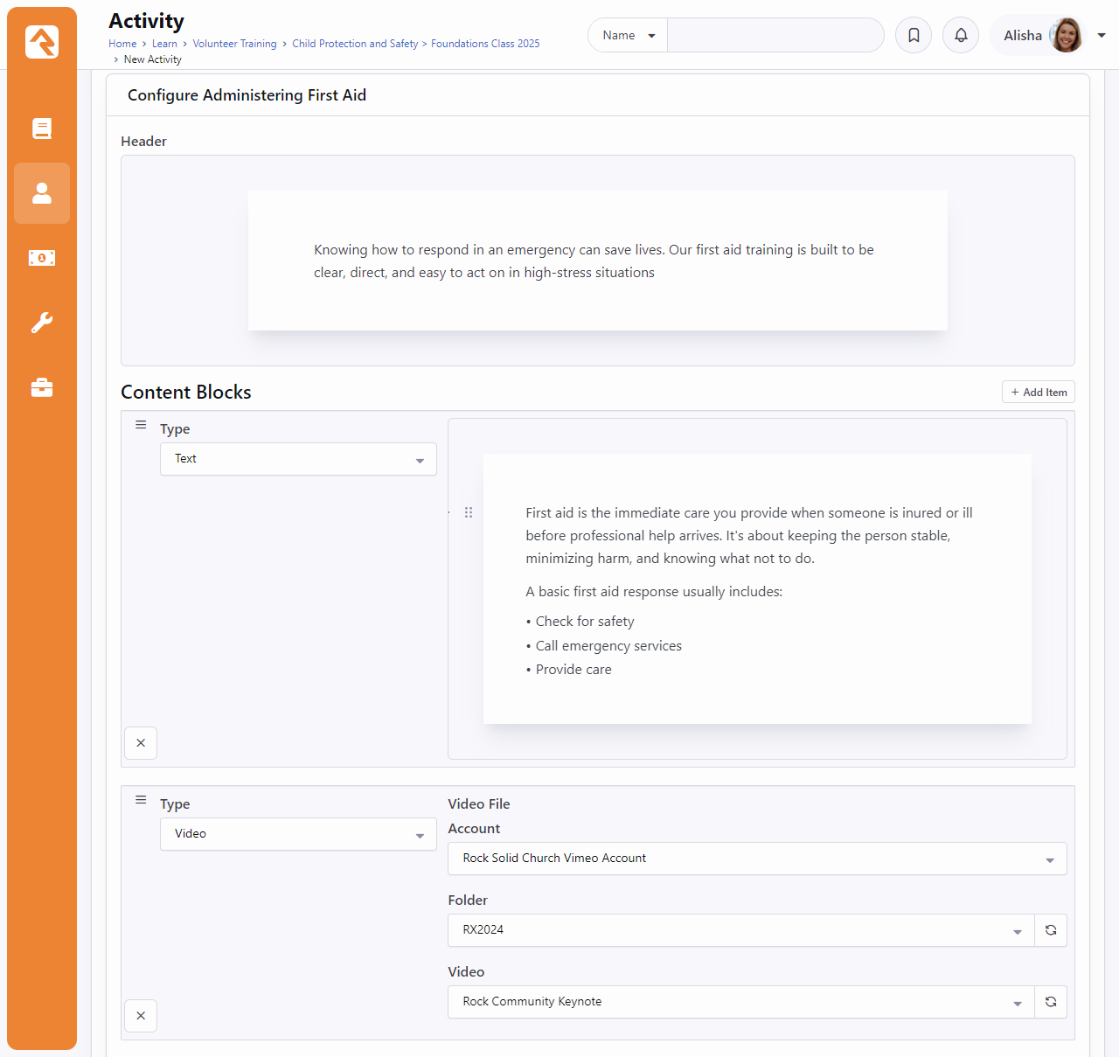
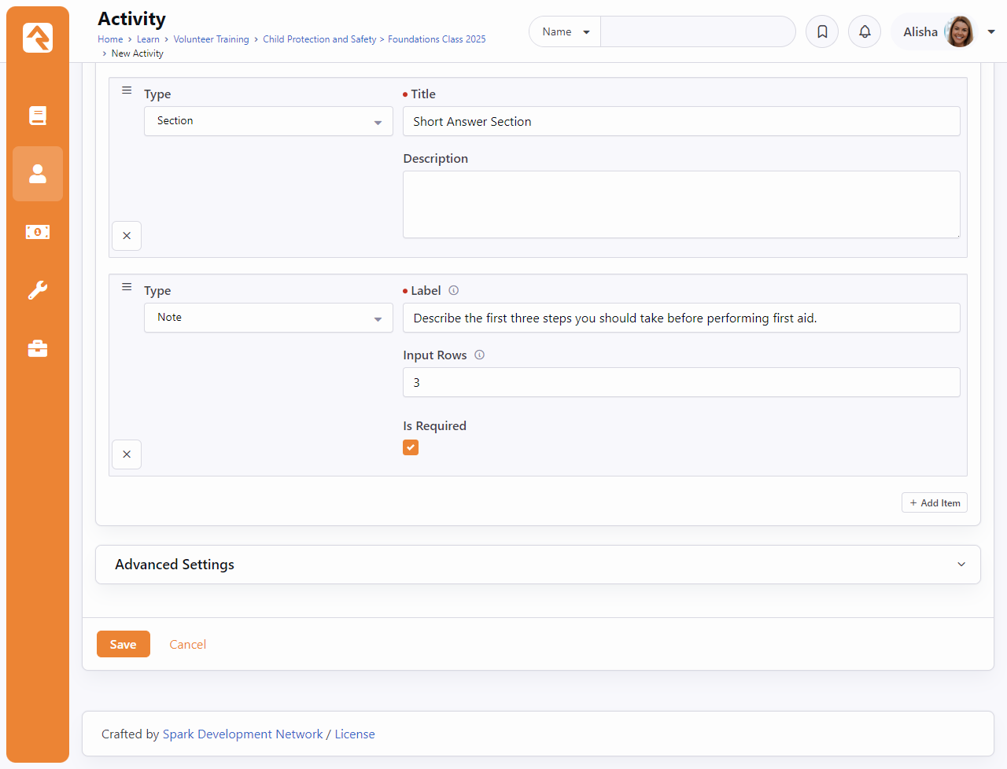
Content Article (v18)
Notes:
Text, Video, Section, and Note
The Content Article activity lets students engage with instructional content by reading text or watching a video. They can then reflect by writing personal notes or answering a prompt—neither of which are graded.it as completed.
These notes are private and visible only to the student.

Slide 36
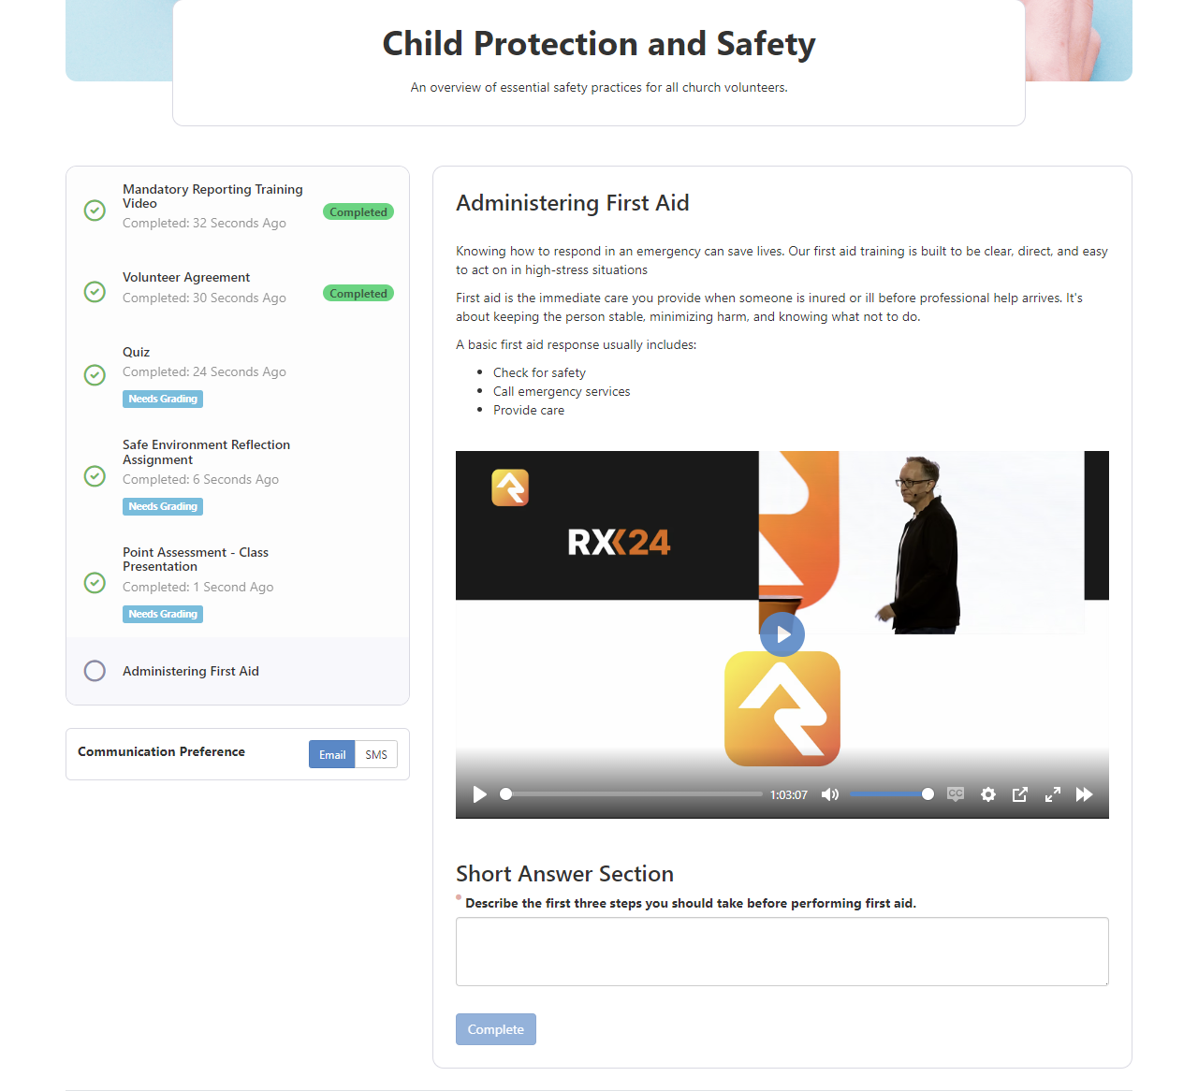
Content Article (v18)
Add structured written content for students
Embed media such as images or videos
Pair with follow-up questions or reflections for the student
Notes:
Text, Video, Section, and Note
The Content Article activity lets students engage with instructional content by reading text or watching a video. They can then reflect by writing personal notes or answering a prompt—neither of which are graded.it as completed.
These notes are private and visible only to the student.

Slide 37
Facilitator Experience

Slide 38
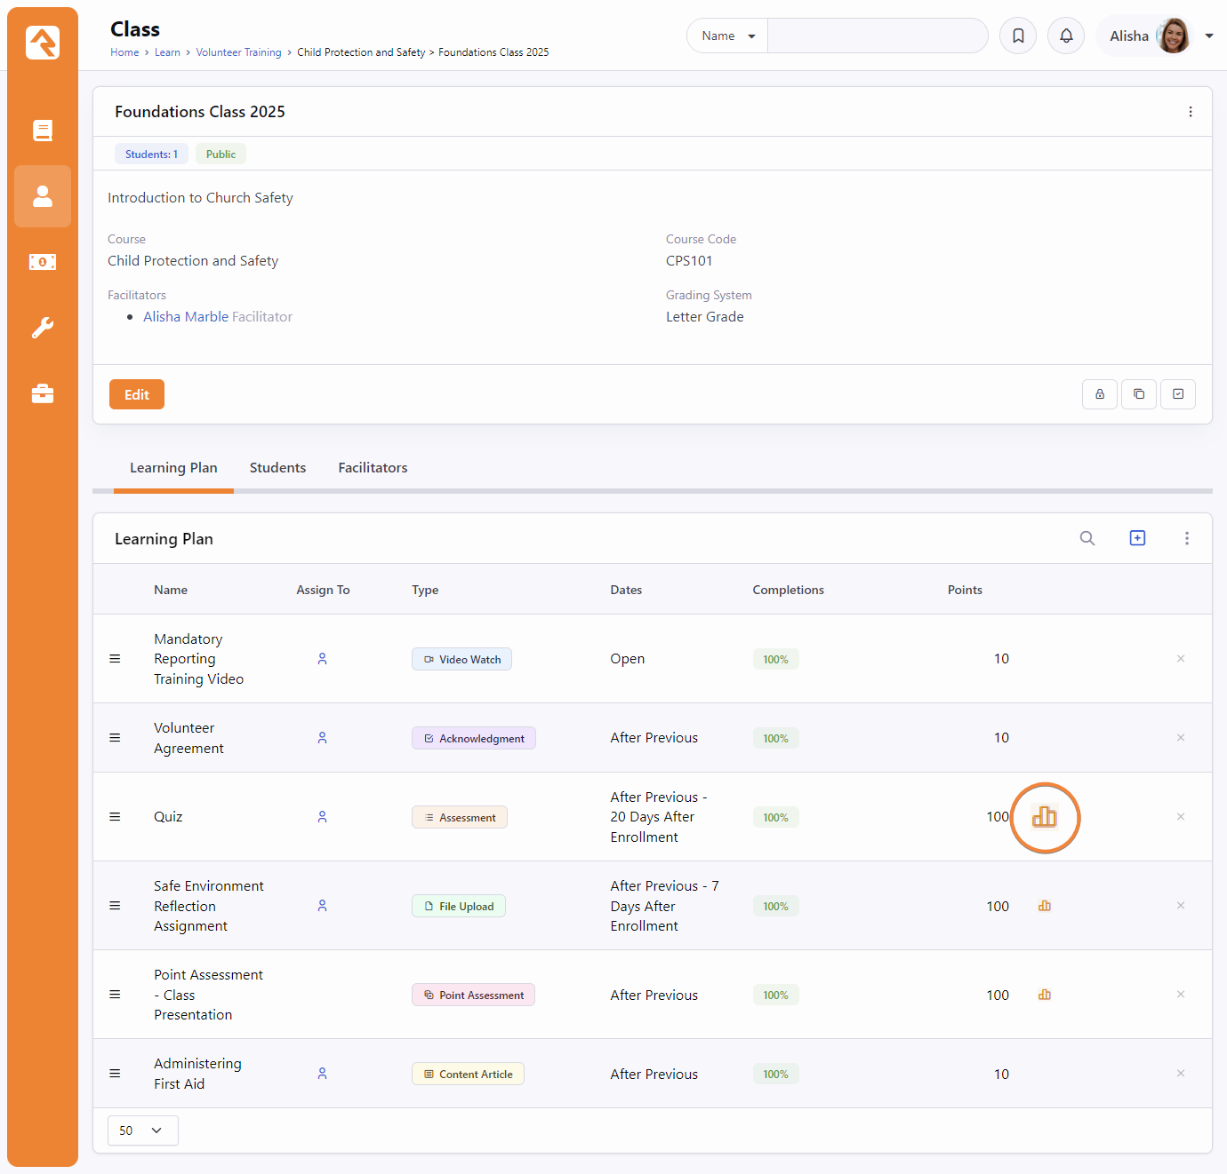
Facilitator Navigation
A facilitator will navigate to the class they are facilitating.
The graph icon indicates which activities a facilitator needs to review
Click on the activity to view completions and begin grading

Slide 39
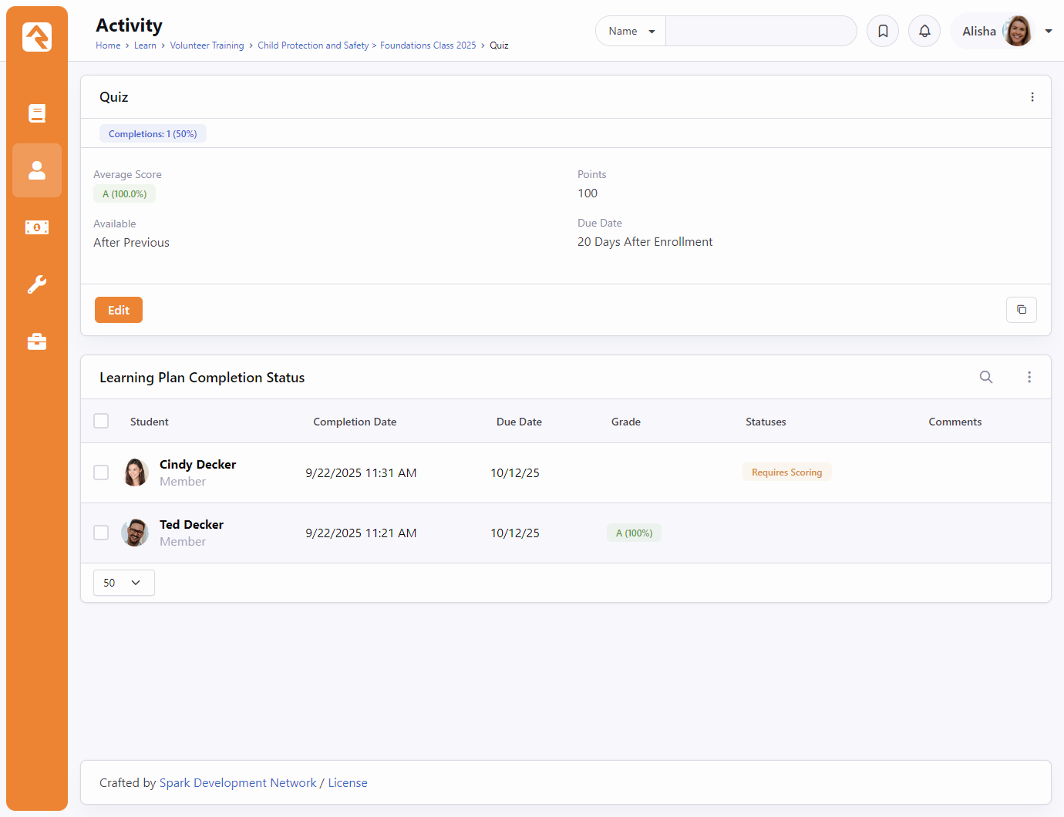
Activity Completion Status
View students who have completed the activity
Click on the student that requires grading to begin the grading process

Slide 40
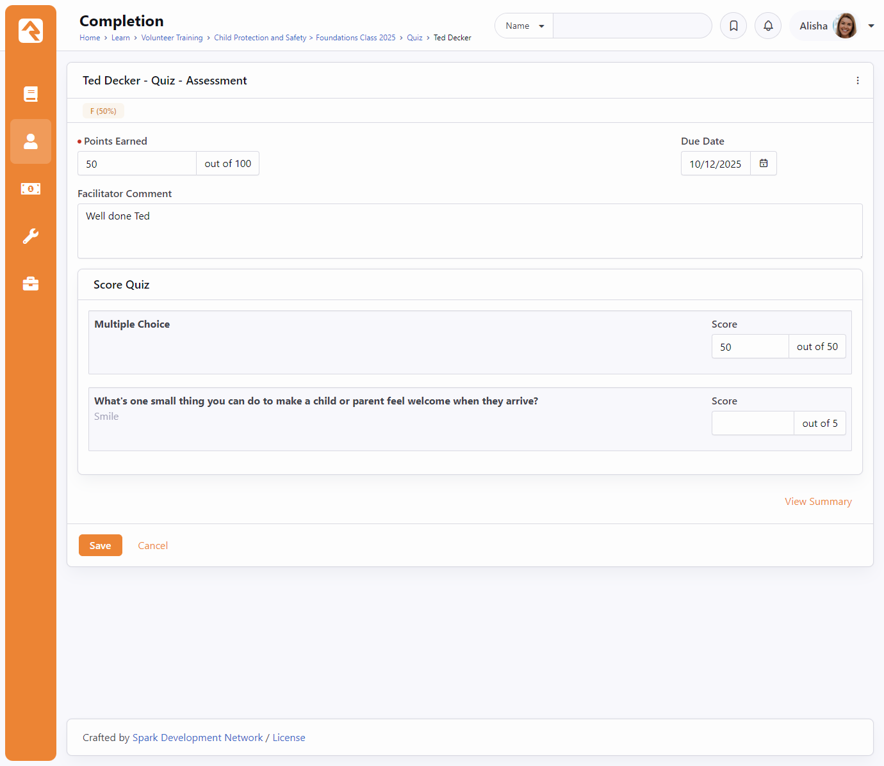
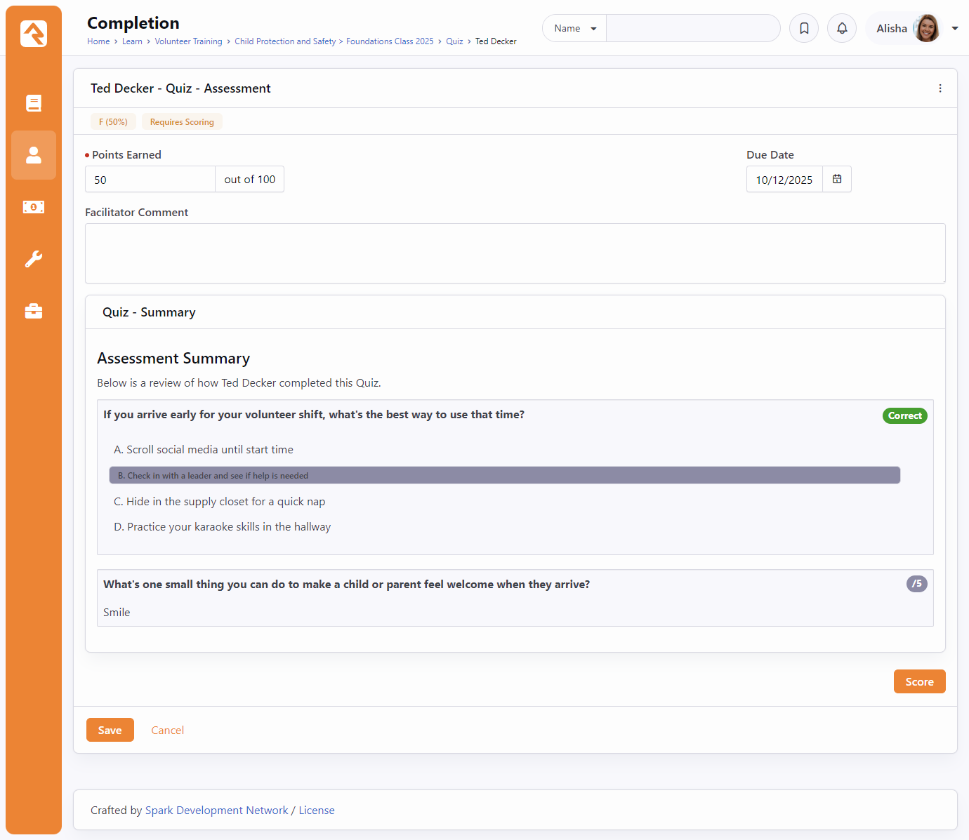
Facilitator Scoring
Scoring View
Summary View
Notes:
Multiple choice is graded automatically, short answer needs to be graded
Same scoring views are available for other activities that require grading (Point Assessment and File Upload)

Slide 41
Grading Systems

Slide 42
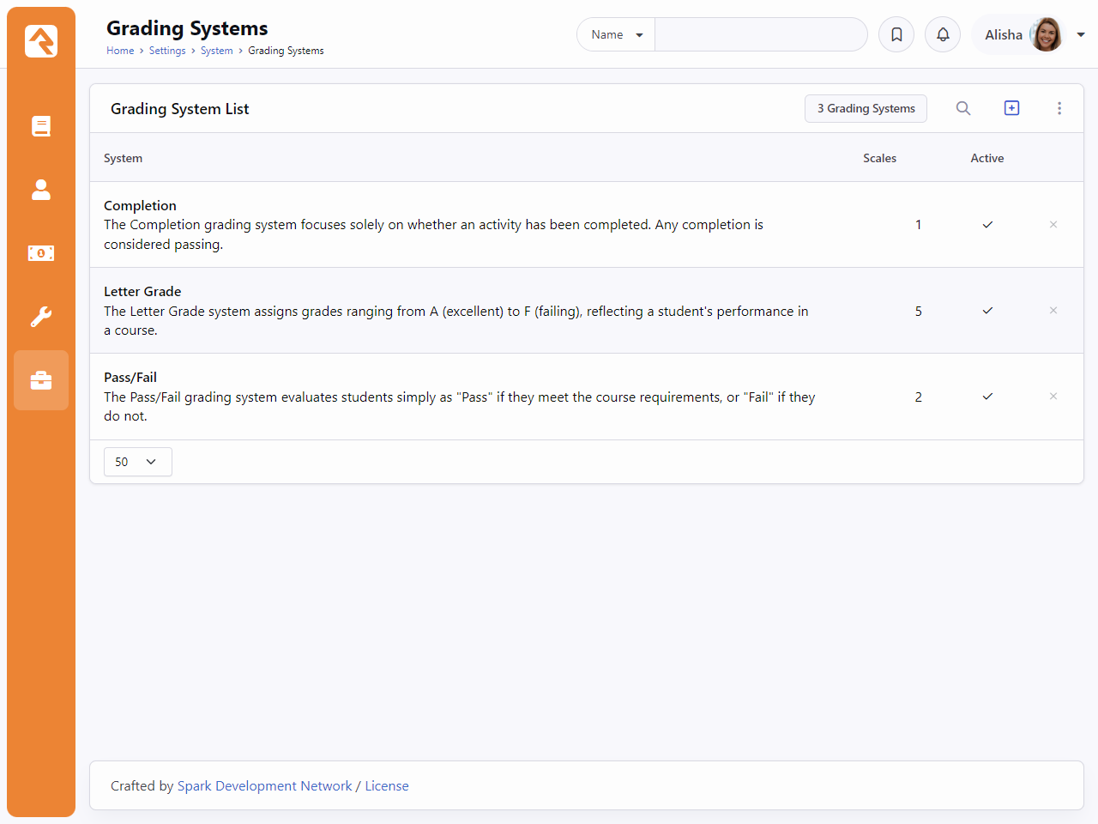
Where to Find Grading Systems
Navigate to /admin/system/grading-system. (Or search for it in the Admin Settings)
These are the Grading Systems that Rock ships with.
You may add more or edit the existing ones to better fit your needs.

Slide 43
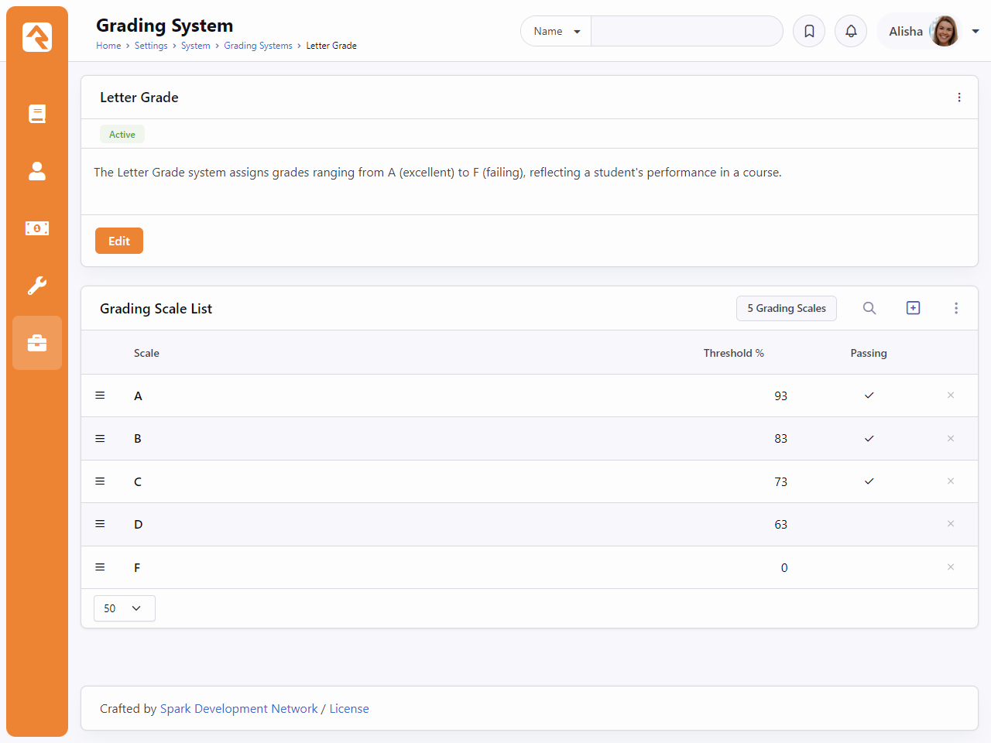
Letter Grade Grading System
These are the letter grade ranges that Rock currently ships with.
Threshold values can be updated to fit your organization’s needs

Slide 44
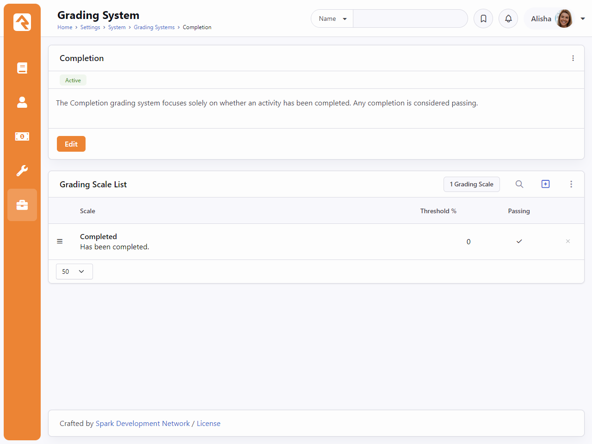
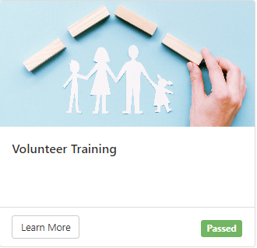
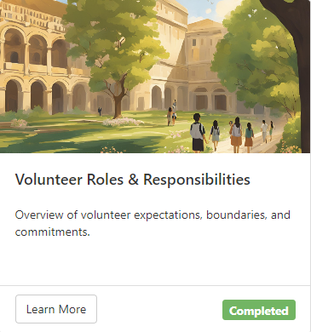
Completion Grading System Expanded in v18
Completion grading systems will now use the name of the Grading Scale rather than “Passed” when showing a completed course in the Learning Hub.
Notes:
Make sure there is at least 1 Grading Scale!
This is configurable via lava block setting on the Learning Hub

Slide 45
LMS: Beyond the Basics

Slide 46
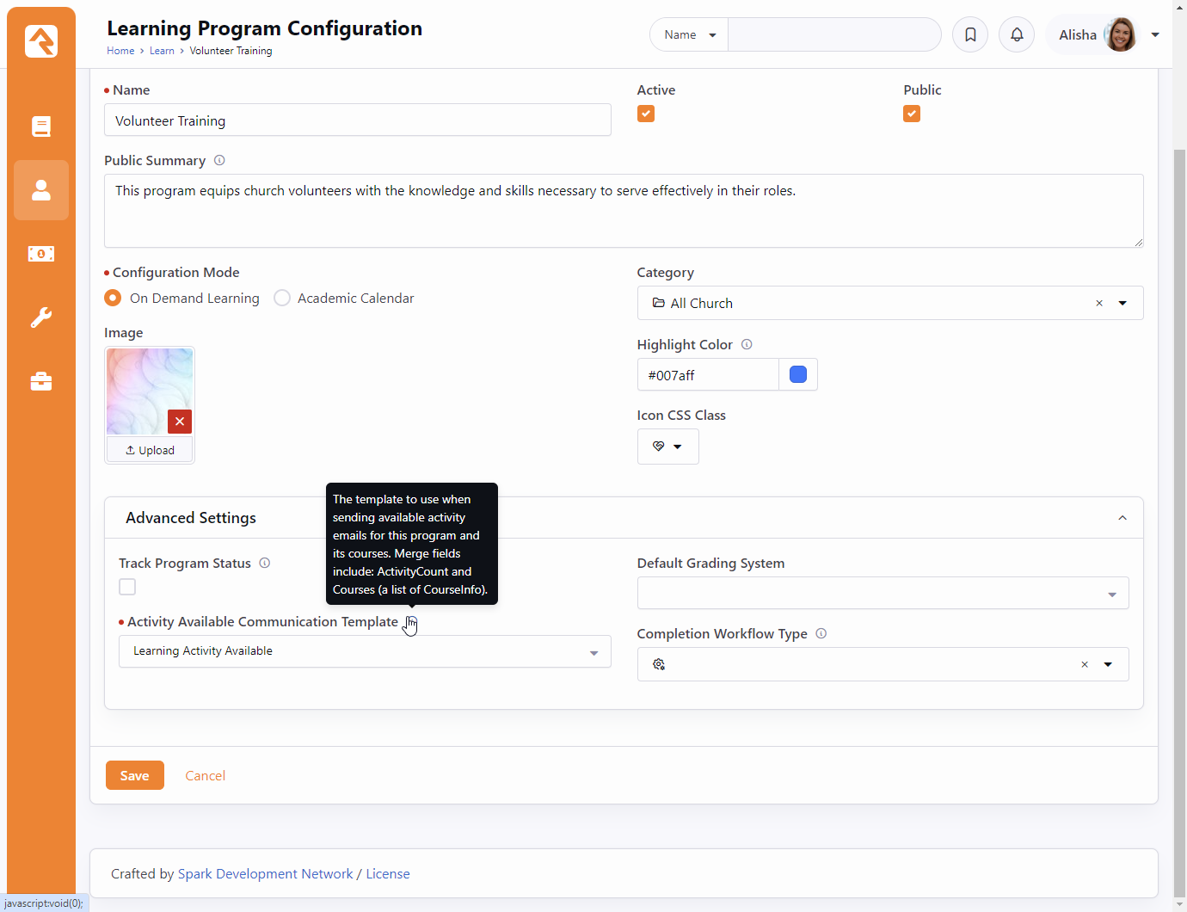
LMS Notifications
Jump back to the edit Learning Program details
In “Advanced Settings” the Activity Available Communication Template defaults to the Learning Activity Available communication template

Slide 47
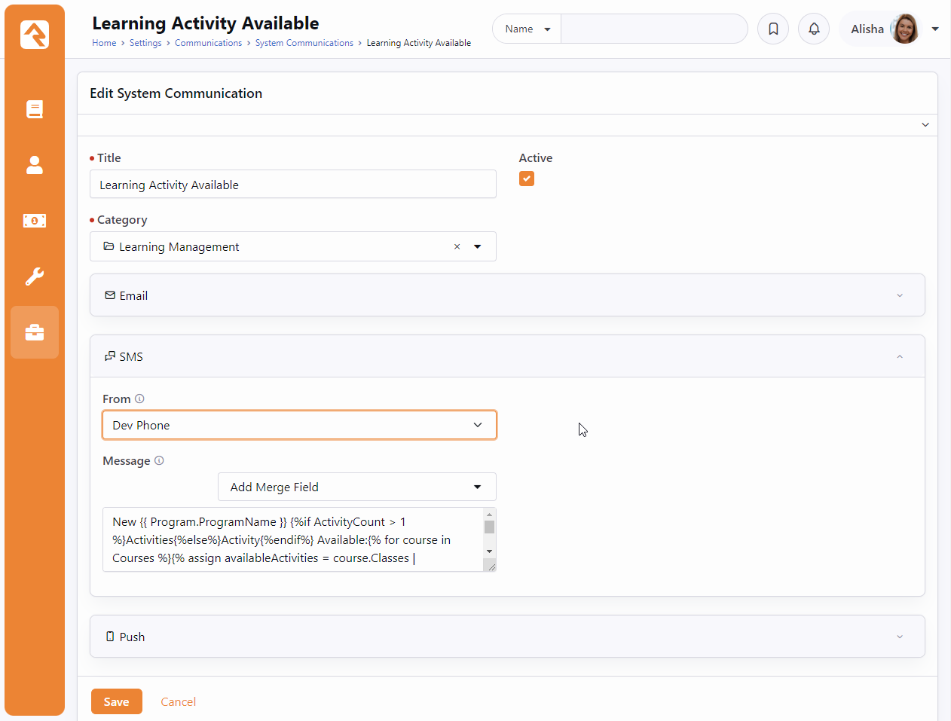
LMS Notifications
To find that “Learning Activity Available” communication navigate to /Communications/System. (Or search for System Communications in admin settings)
New in v18, we’ve added support for SMS notifications about Learning Activities. You’ll want to navigate to this System Communication and select your “From” phone number to get that up and running.

Slide 48
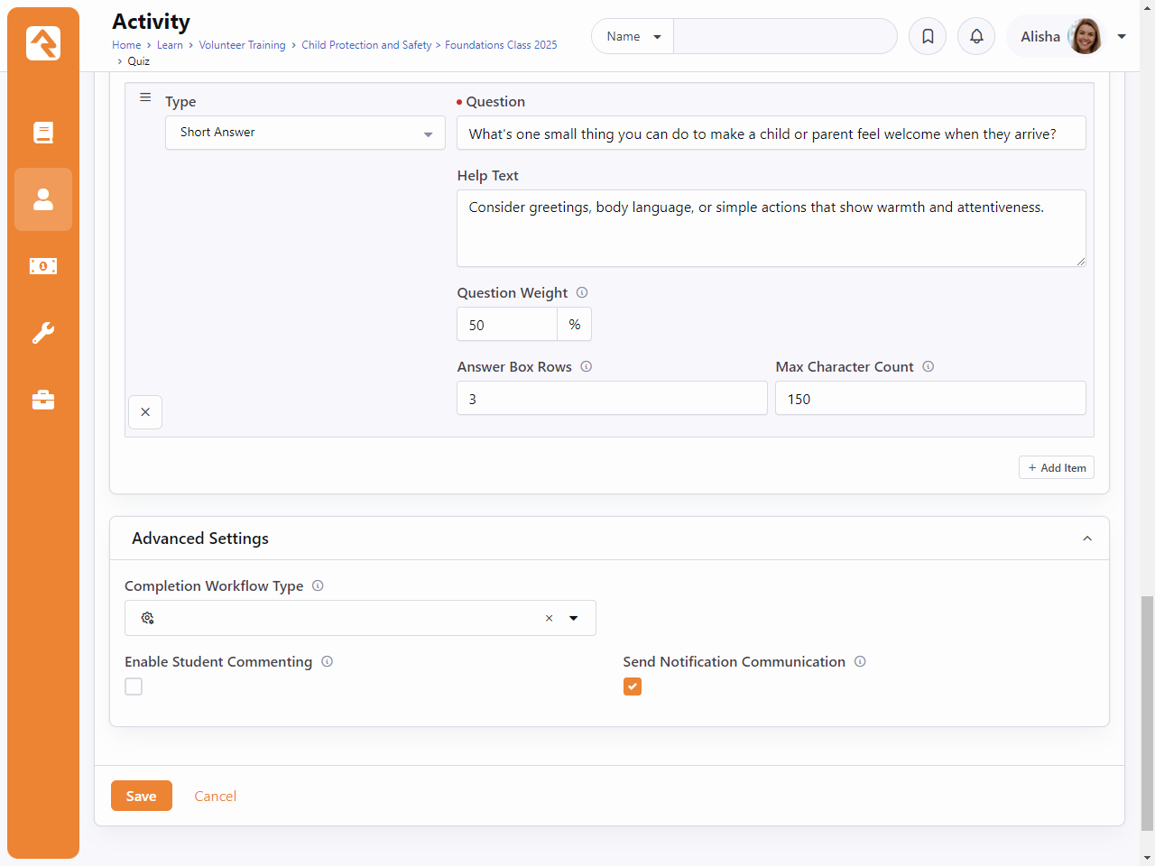
LMS Notifications
Next, you’ll want to head over to an activity that you want students to be notified about and expand the “Advanced Settings”
Enable the “Send Notification Communication” checkbox

Slide 49
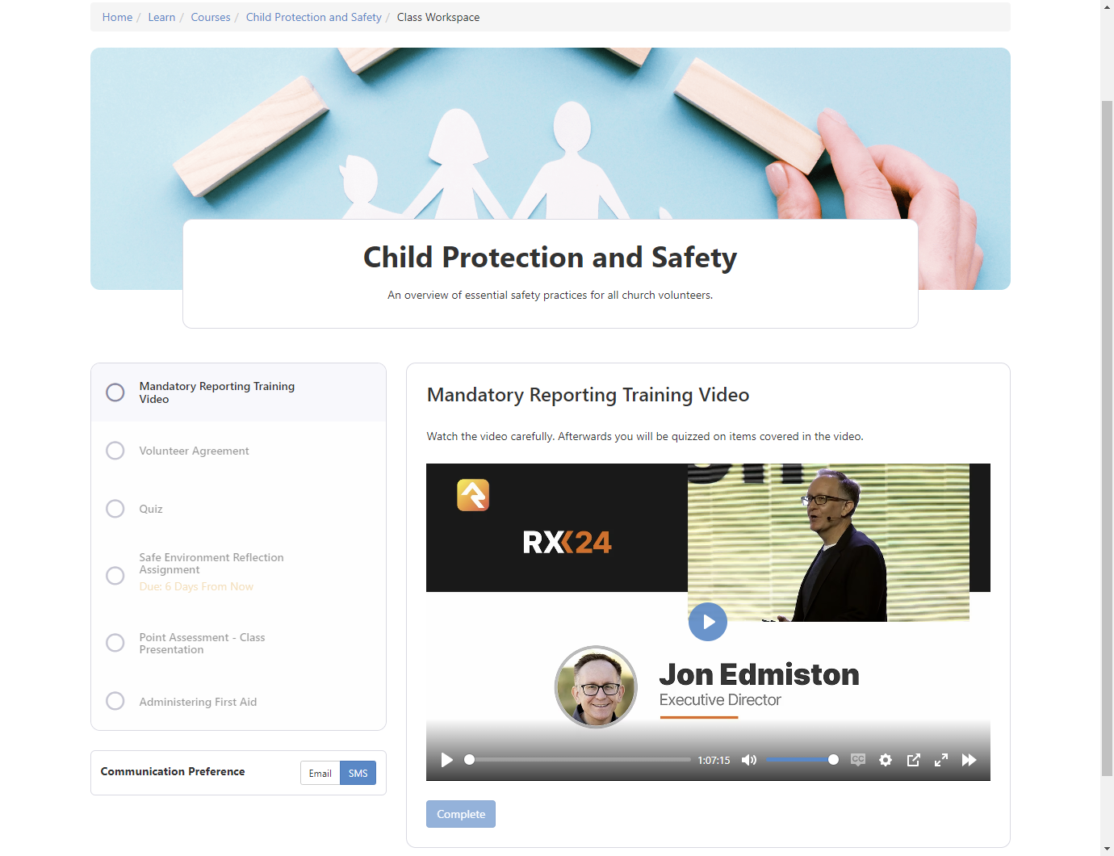
LMS Notifications
See the Communication Preference in the bottom left.
This feature was added in v18 and will default to the person’s communication preference.
This value determines whether the individual will receive SMS messages or emails about newly available LMS activities.

Slide 50
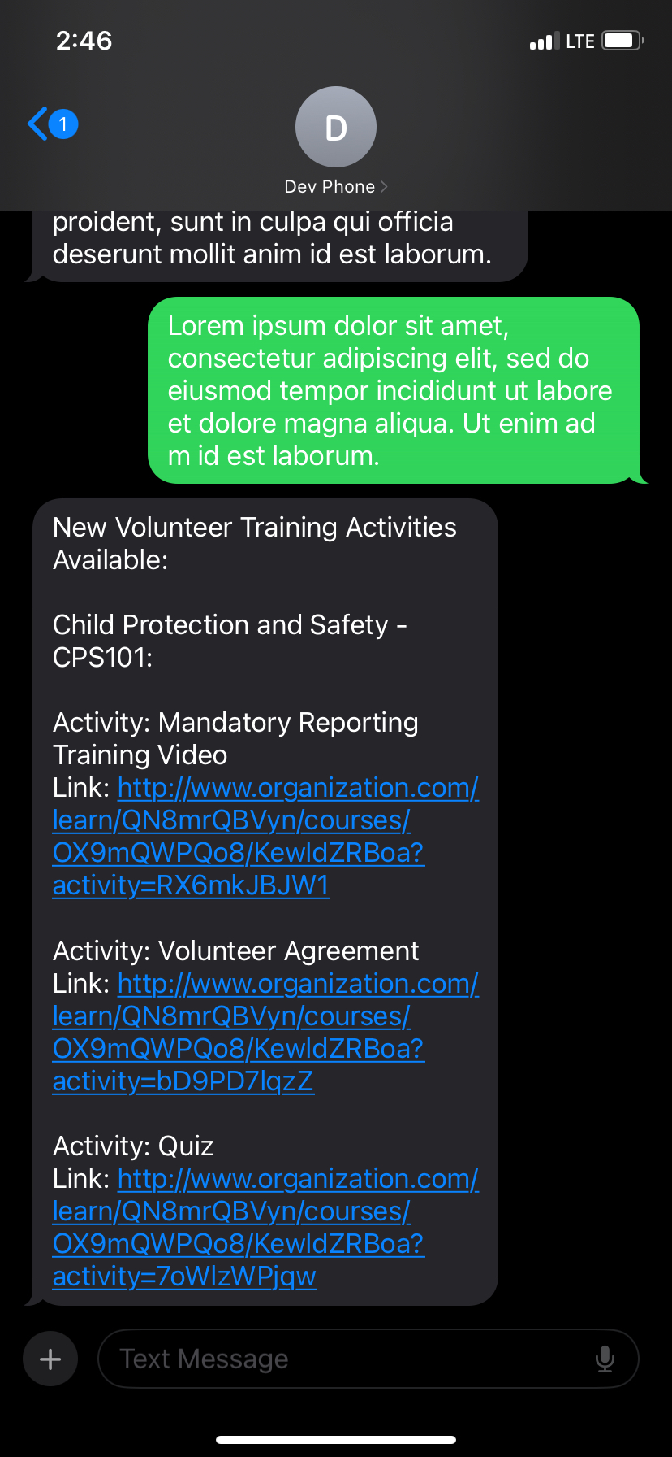
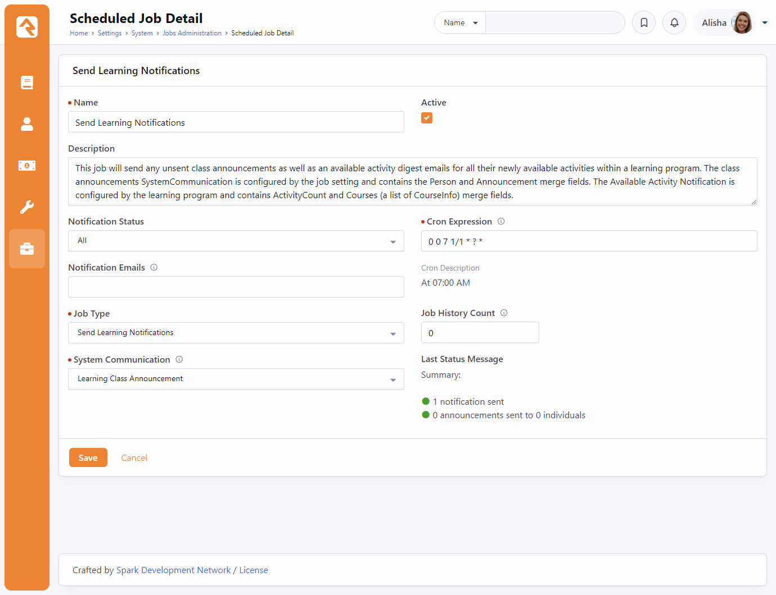
LMS Notifications
The “Send Learning Notifications” job will run every day at 7am and send out these notifications if the program and activity have been configured.

Slide 51


Academic Calendar
Notes:
Academic Calendar mode.
Semesters.

Slide 52


Academic Calendar
Notes:
Content (Syllabus)
Announcements (scheduled, email, sms, or post to class page)

Slide 53

Academic Calendar: Learning Hub
The Learning Hub now shows a class overview detailing: class progress, announcements, and notifications.
Nav bar takes you to Class Overview, Activities/Assignments, and the Syllabus (class content)

Slide 54
Q&A

